Slide 1
Voice of the Client- Using Mobile Phones and IVR Technology to Understand Client Satisfaction
Outcomes Working Group Webinar
November 7th, 2017
#MIXVOC

Slide 2
Today’s Agenda – Voice of the Client
Voice of the Client (VoC): Background on the pilots
VoC Cambodia and Peru: Project setup and implementation
Application of IVR to measure client outcomes
#MIXVOC

Slide 3
BACKGROUND ON THE PILOT PROJECTS
#MIXVOC

Slide 4
There is limited information and insight into client satisfaction
PROBLEM
1. Clients are often missing in the feedback loop
2. The industry’s client-level data infrastructure is weak
3. Current data collection practices can be strengthened
#MIXVOC

Slide 5
Client input should be included in institutional decision making
PROBLEM
1. Clients are often missing in the feedback loop
2. The industry’s client-level data infrastructure is weak
3. Current data collection practices can be strengthened
PROPOSED SOLUTION
1. Center feedback and research efforts around clients
2. Allow for comparability of data across institutions
3. Employ a bottom-up approach and is proactive
#MIXVOC

Slide 6
Voice of the Client addresses the need for comparable client-level data
To address the need for comparable, client-level data, Hivos and MIX developed the Voice of the Client initiative.
The idea of the VoC initiative was originally conceived by Hivos, building on its citizen monitoring experiences in fields outside of microfinance.
Hivos was the principal funder of the first two pilots in India and Peru, which were coordinated jointly by MIX and Hivos.
#MIXVOC

Slide 7
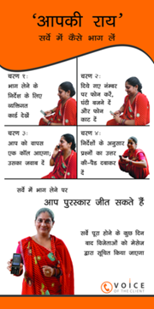
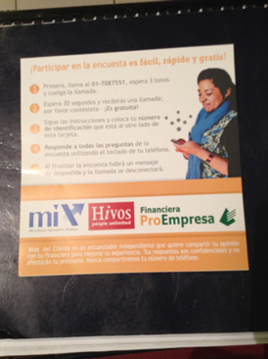
We piloted the project in India and Peru in 2014 and 2015
We interviewed clients using a questionnaire that focused on 5 of the 7 Client Protection Principles.
We used three different methodologies:
Interactive Voice Response (IVR)
Call centers
Face-to-face
India (June – November 2014)
5,898 women active clients interviewed
Location: Delhi and Uttar Pradesh
FSPs: Cashpor, Satin, Sonata, and Ujjivan
Peru (June – November 2015)
3,767 women active clients interviewed
Location: Lima
FSPs: CMAC Arequipa, Fondesurco, Financiera Compartamos, and Financiera ProEmpresa
#MIXVOC

Slide 8
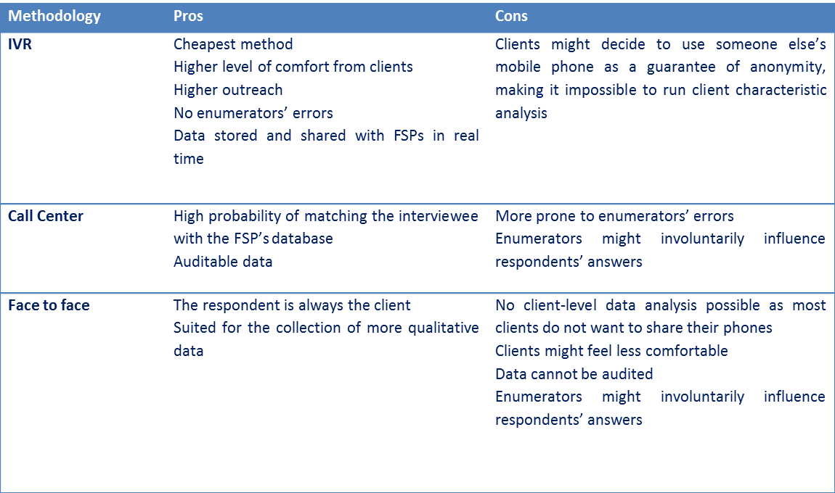
Comparison of three methodologies
#MIXVOC

Slide 10
PROJECT SETUP AND IMPLEMENTATION IN CAMBODIA AND PERU
#MIXVOC

Slide 11
Key figures, timeline, and stakeholders
 | Cambodia | Peru
# of clients interviewed | 1,698 active borrowers | 2,996 active borrowers
Data collection timeframe | Mid-April thru end of June | Beginning of June thru end of July
Donors | Cisco Foundation The Global Commercial Microfinance Consortium II (“Consortium II”) | Cisco Foundation
Project partners | CMA (country network) AMK IPR MAXIMA PRASAC | ADRA Peru Confianza Manuela Ramos MiBanco
Technical partner | Viamo (formerly, VOTO Mobile and HNI)
#MIXVOC

Slide 12
Legal landscape
MIX had templates of the standard service agreements and non-disclosure agreements that we tailored for each FSP.
Cambodia – No major concerns with the contracts. However, the National Bank of Cambodia issued an 18% interest rate cap on all MFIs (the market average fell around 24%), which disrupted the setup and implementation of the pilot. One FSP had to bow out of the project, citing major changes in operations. The key learning here was that although there was no way to predict the rash implementation of the regulation, it’s always a good idea to keep a pulse on the political climate.
Peru – Navigating this phase of the project took far longer than anticipated – delaying the start by approximately 1.5 months! -- because national regulation governing data privacy laws are incredibly tight. The key learning here is to have your legal team on call and ready to negotiate.

Slide 13
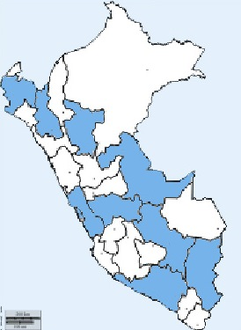
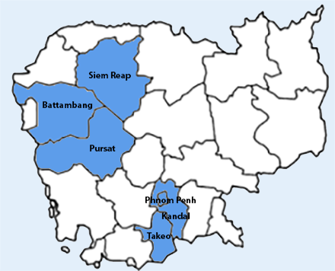
Sample selection
Key criteria in both markets
2nd cycle borrowers or older
Gender representation
Asked FSPs to send us a database extract of at least 5,000 clients, considering average participation rate is 20%
Unique considerations for each market
Multiple borrowing is a huge concern in Cambodia
Had to avoid the northern departments in Peru due to floodings
#MIXVOC

Slide 14
Survey questionnaire (1/2)
The survey focused on 5 out of 7 of the Smart Campaign’s client protection principles (CPPs):
Appropriate product design
Prevention of over-indebtedness
Transparency
Fair and respectful treatment of clients
Mechanisms for complaint resolution
*(6) Responsible pricing and (7) privacy of client data were omitted in order to keep the survey to a manageable length and minimize the drop-out rate.
The participating FSPs provided significant input on the questionnaire, which is comprised of 18 and 19 multiple choice questions in Cambodia and Peru, respectively.
#MIXVOC

Slide 15
Survey questionnaire – sample questions (2/2)
Appropriate product design
What do you think about the size of your current loan?
What do you think about the installment size of your current loan?
Prevention of over-indebtedness
Have you ever made a late payment for your current or a previous loan? (In Peru, we only asked about current loan)
Have you ever had to sell an asset to make a payment for your current or a previous loan?
Have you ever had to borrow from another source to make a payment for your current or a previous loan?
Have you ever had to reduce your expenses on basic necessities to make a payment for your current or a previous loan?
Transparency
Do you believe you that you were clearly informed about your loan interest rate before accepting your current or a previous loan?
Do you believe you that you were clearly informed about your loan fees before accepting your current or a previous loan?
Fair and respectful treatment of clients
Have you ever been disrespected by a staff member?
Have you ever been asked by a staff member to pay a bribe or commission for which you did not get a receipt?
Mechanisms for complaint resolution
Do you believe you were properly informed about how to make a complaint?

Slide 16
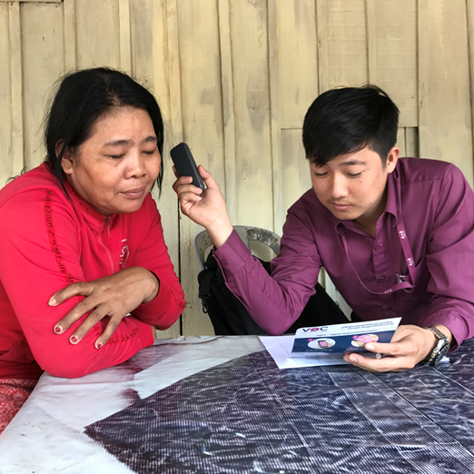
Survey audio recordings
After a number of challenges with the studio that VOTO hired to do the recordings in Cambodia, MIX decided to independently hire a local studio to complete the recordings in both Cambodia and Peru.
The average duration to complete the survey in full is 8 minutes.
#MIXVOC

Slide 17
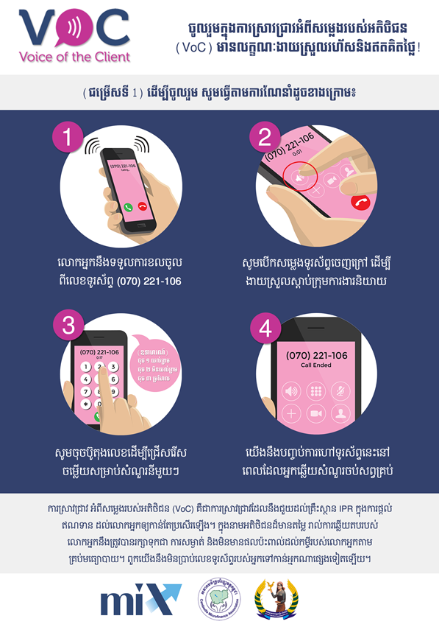
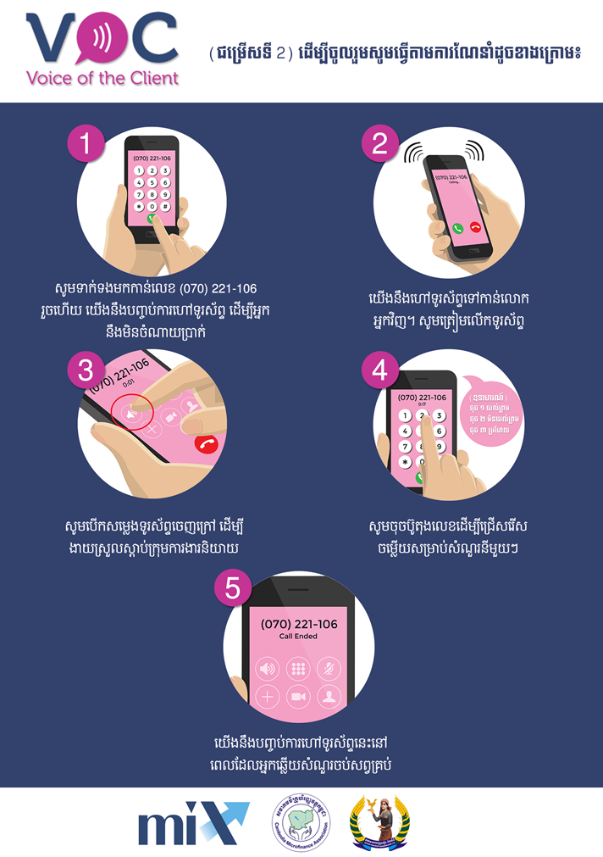
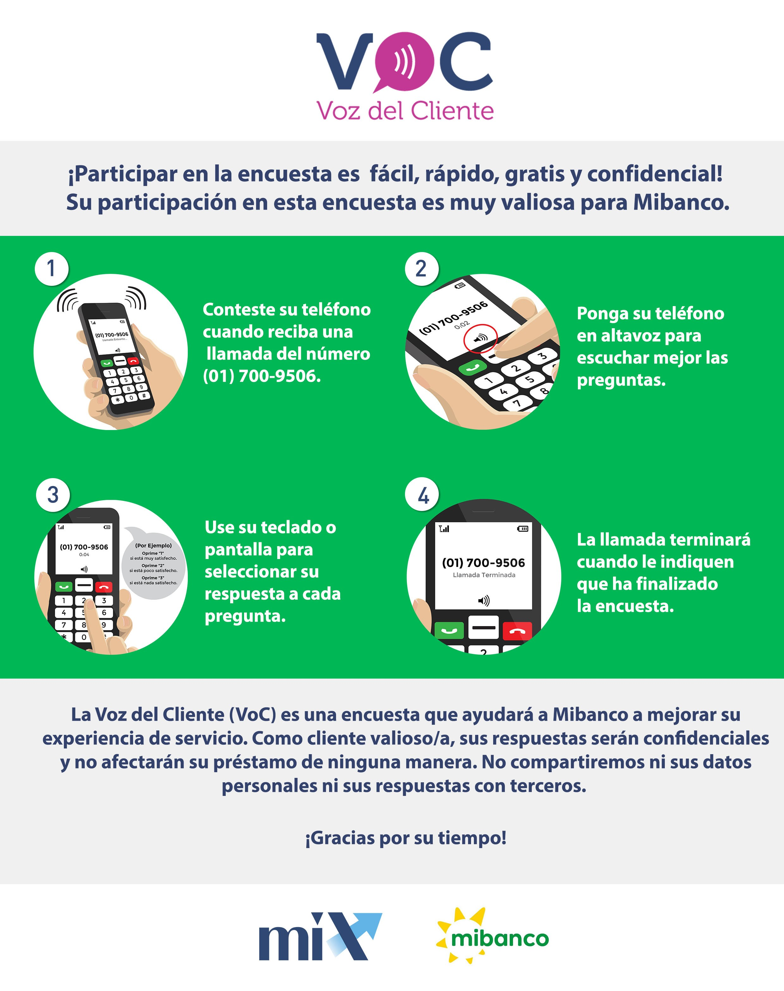
Flyer design
Key differences in flyer design process
Cambodia | Peru
Double-sided Tried to put as much information as possible | One page A more minimalist style
#MIXVOC

Slide 18
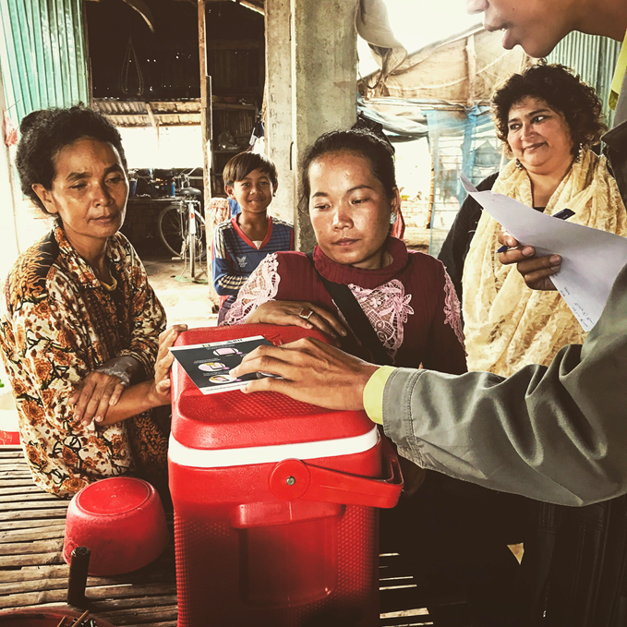
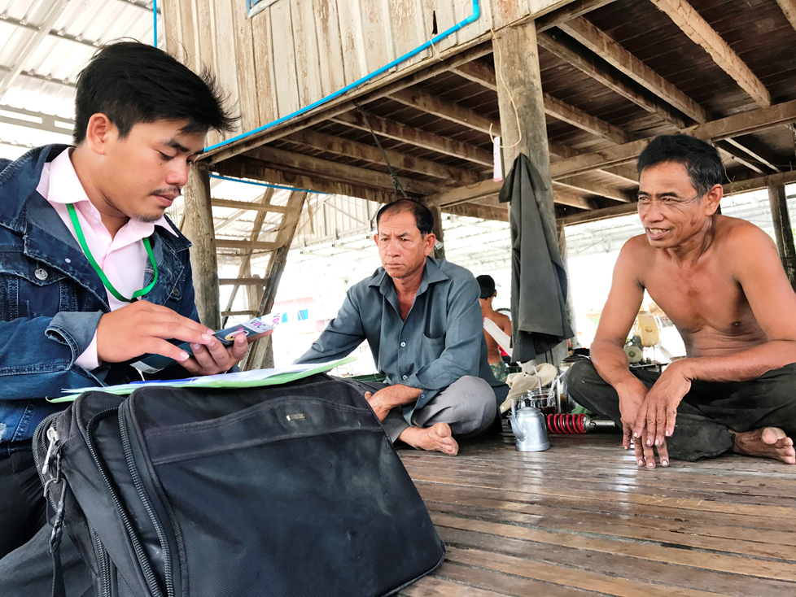
Client sensitization – Process (1/2)
FSP loan officers were trained and tasked with promoting survey participation during repayment and loan disbursement sessions amongst clients who were pre-selected to participate in the survey.
This allowed loan officers to demonstrate the survey tool in person and distribute the survey flyers.
#MIXVOC

Slide 19
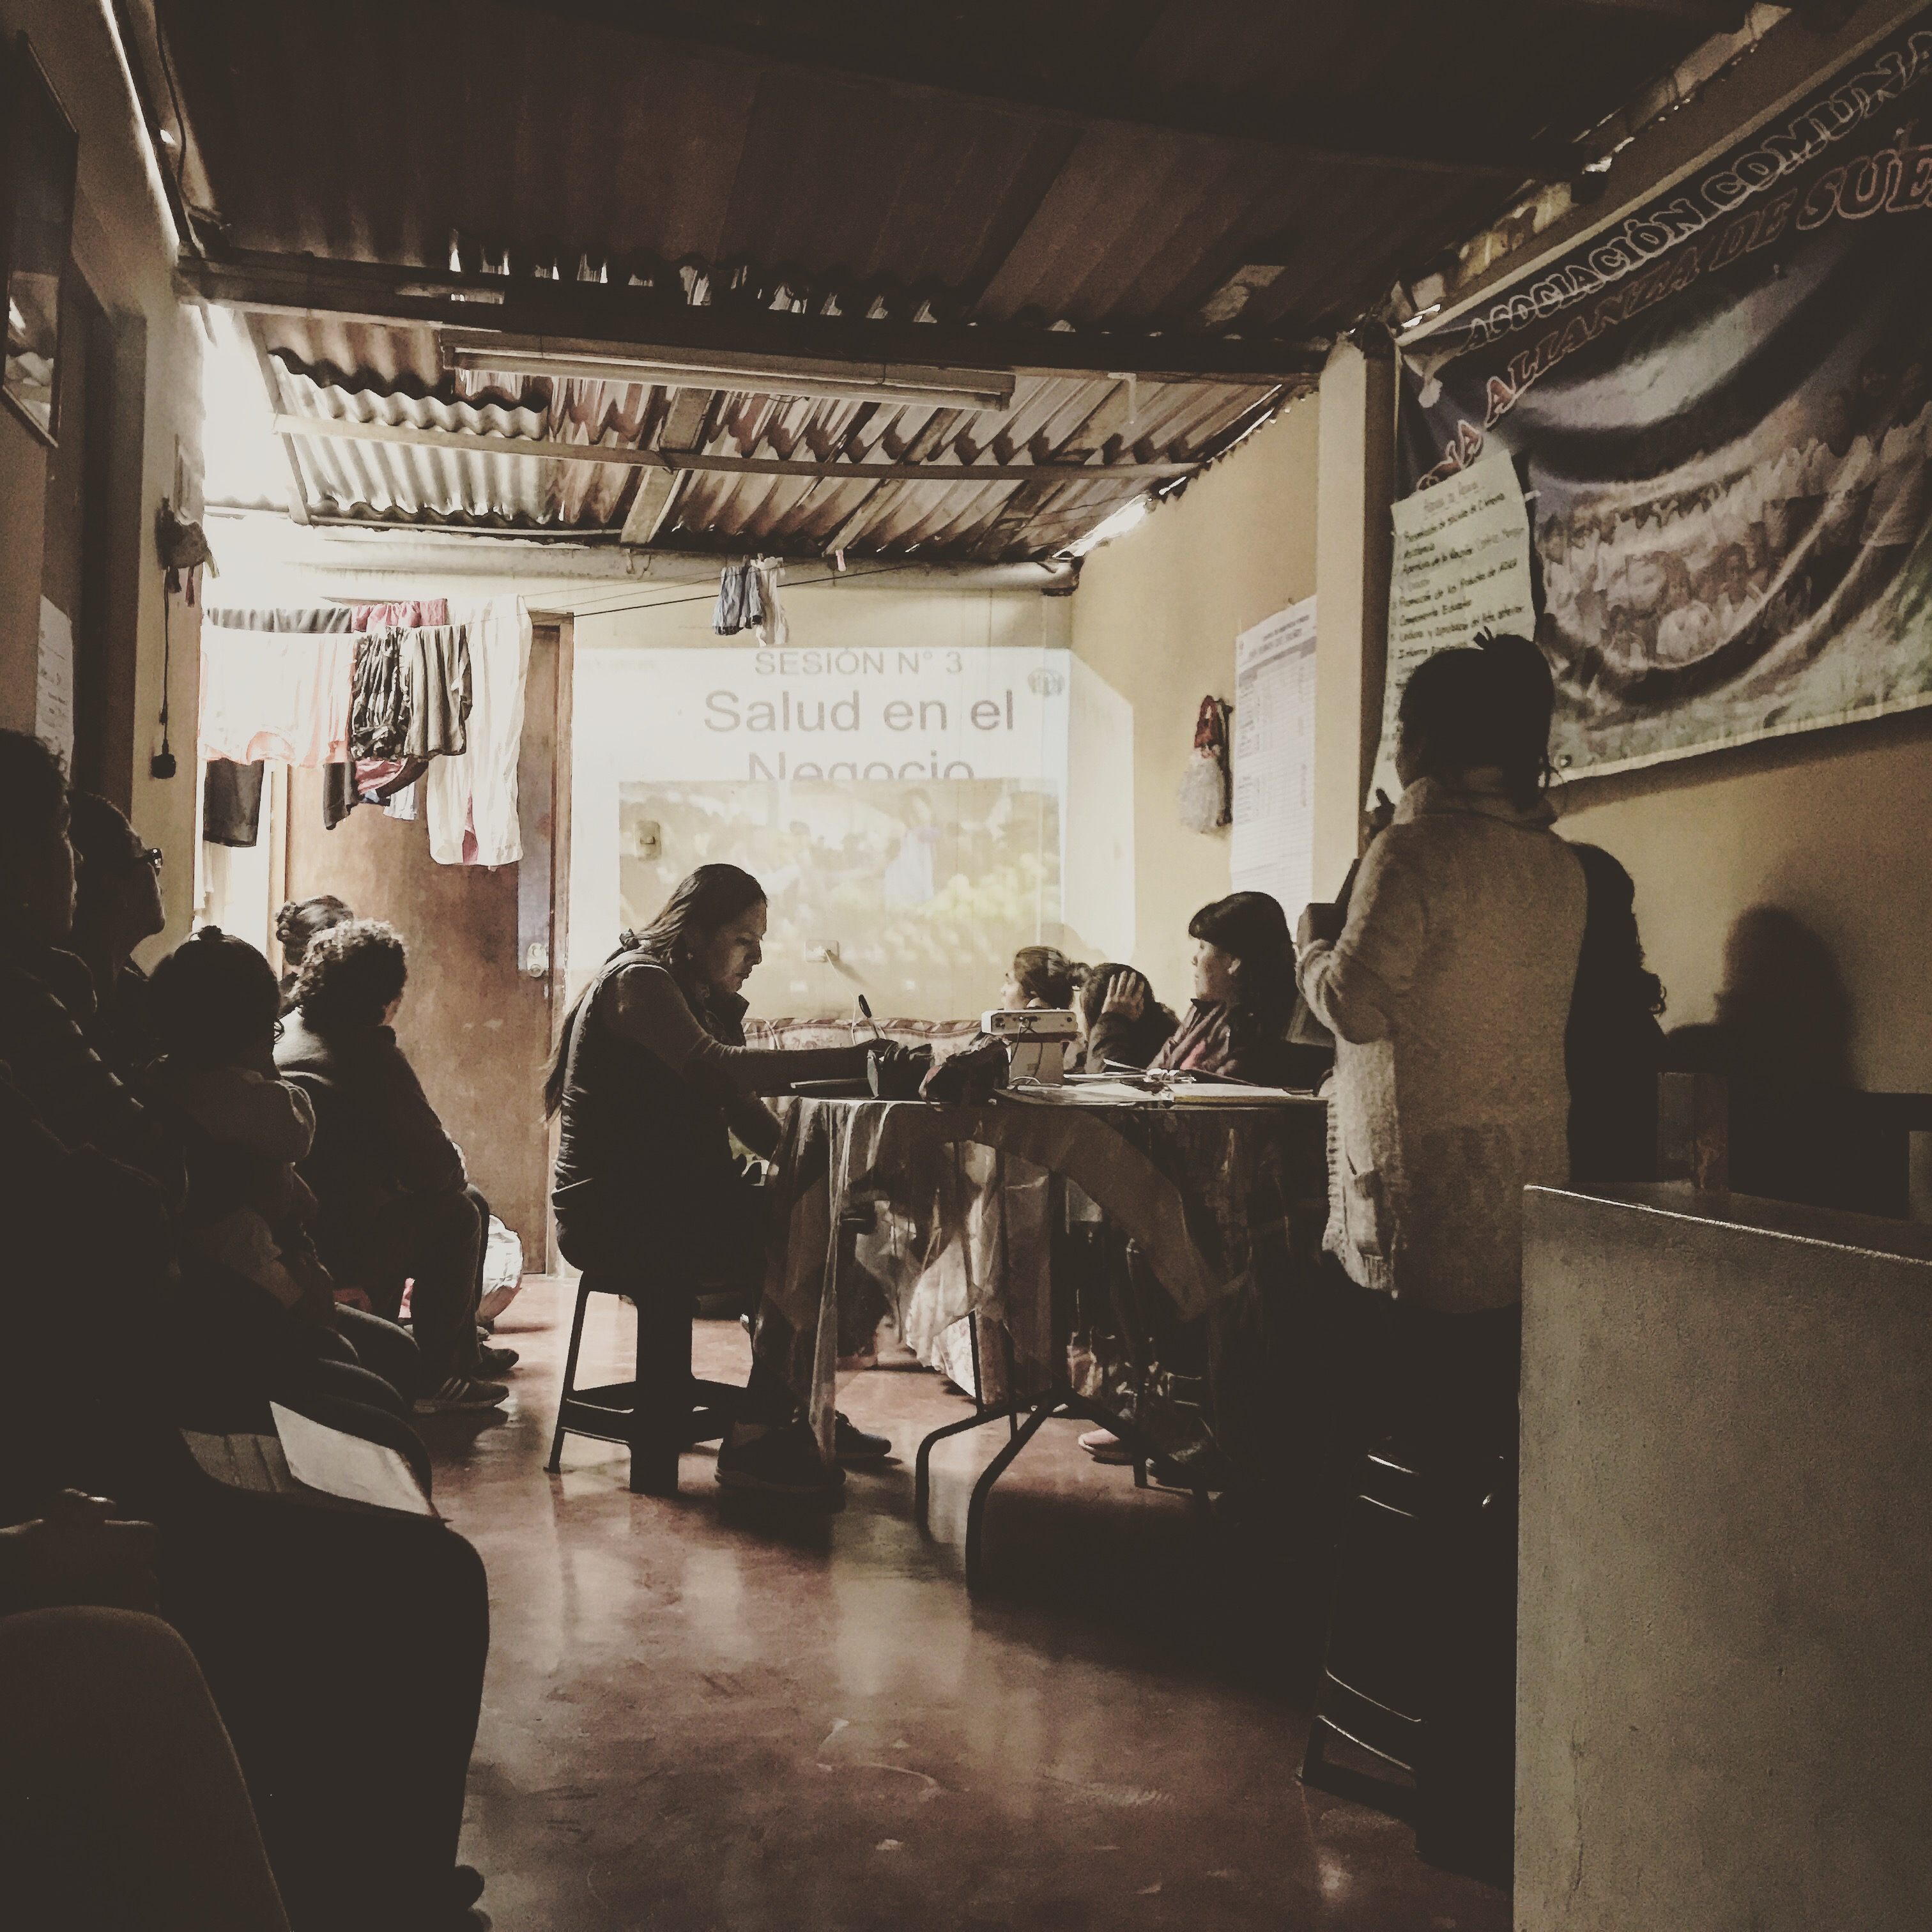
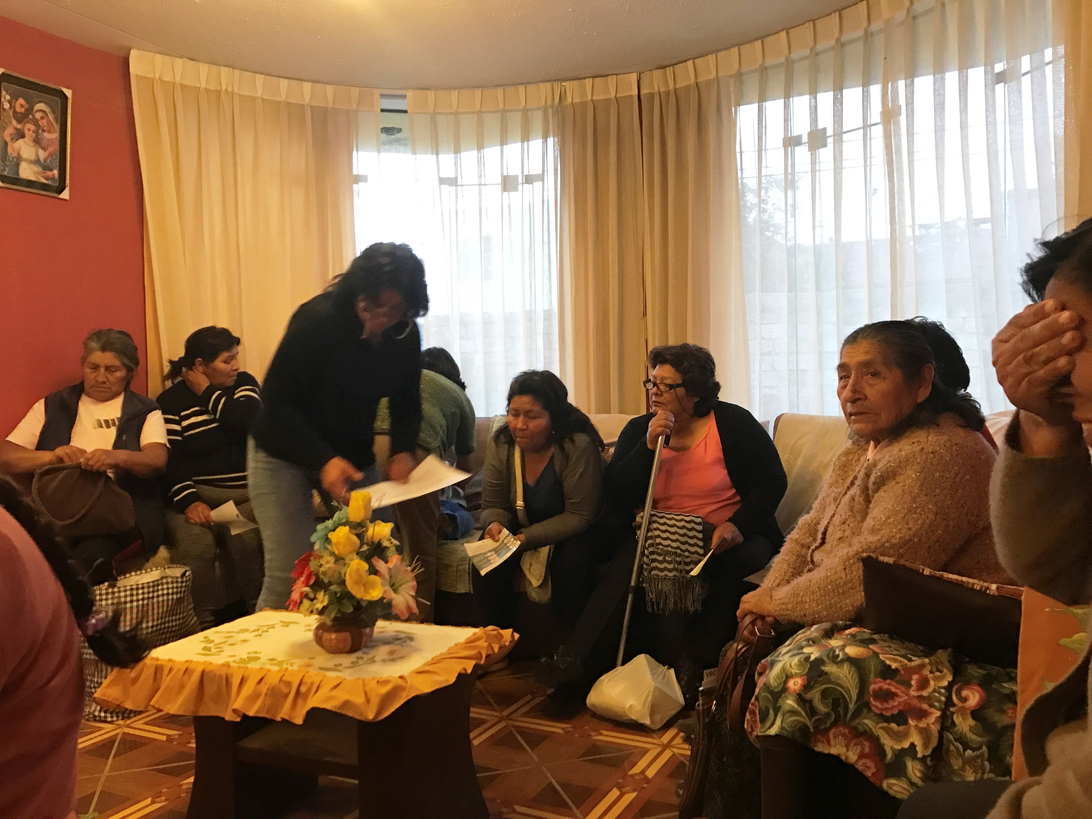
Client sensitization – Main challenges (2/2)
Although we trained the credit officers on how to communicate to clients about the survey, we had limited resources to do a quality control.
In order to reach our target sample size for several FSPs, we had to extensively push out calls who were not sensitized; average participation rate for non-sensitized clients is 2%-4% vs. 20% for those who have been sensitized.
Noticeable difference in participation rate between regulated / more commercial FSPs and NGOs (individual lending vs. village banking models).
For many clients, their cell phone use is limited to texting and making/receiving short calls.

Slide 20
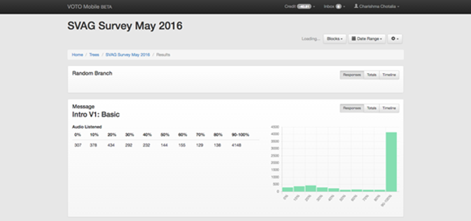
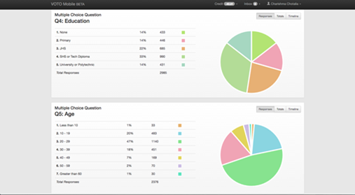
Data collection
All survey responses were recorded VOTO Mobile’s online platform (see video demo: https://www.votomobile.org/our-platform/).
There are two ways of collecting data via IVR:
Clients can receive calls from the computer platform
Clients can call a hotline that will be assigned to each participating FSP. The call is free of charge to clients.
MIX monitored the calls received and made through the VOTO Mobile platform on an on-going basis.
#MIXVOC

Slide 21
KEY FINDINGS FROM CAMBODIA AND PERU
#MIXVOC

Slide 22
Areas of strength in Cambodia (1/2)
The majority of clients reported being satisfied with their FSP’s loan product design, finding the loan amount and installment size to be adequate.
Perception of current loan size |  | Perception of instalment size of current loan
#MIXVOC

Slide 23
Areas of strength in Cambodia (2/2)
Clients also seem to be generally well-informed of their loan terms, with most of them reporting being aware of their loan interest rates and loan fees.
Clearly informed about interest rate |  | Clearly informed about loan fees
#MIXVOC

Slide 24
Areas of strength in Peru (1/2)
Most clients seem to be generally satisfied as a result of their experience with their respective financial services providers and cite the cordiality and friendliness with which they are treated by the staff members of financial service providers, the ease of growing their businesses and the attractive interest rates on your loans as the main reasons that contribute to your satisfaction.

Slide 25
Areas of strength in Peru (2/2)
Of the 11% of clients who filed a formal complaint, most were satisfied with the resolution of their complaint and the time it took to resolve it.

Slide 26
Areas of weakness in Cambodia
Over-indebtedness: Between one-fifth and one-third of all clients sampled have had to take measures – including selling assets, borrowing from other sources, and cutting down expenses on basic needs – in order to make their payments for a current or previous loan.
Complaint mechanism: The survey results point to the limited use of the complaint mechanisms that are available to clients. Specifically, clients who had experienced mistreatment by an FSP staff and/or who had been asked to pay an amount other than the principal and interest fees without being provided with a receipt did not report their experiences to their FSP.
Informed about complaint mechanism
#MIXVOC

Slide 27
Areas of weakness in Peru (1/3)
Approximately 11%, 6% and 19% of the clients in the sample resorted to loans from other sources, sale of assets and reduction of expenses in basic needs, respectively, to make payments on their loans.
El cliente ha tenido que vender alguno de sus bienes personales |  | El cliente ha tenido que reducir sus gastos por necesidades básicas
n = 2.983 |  | n = 2.984

Slide 28
Areas of weakness in Peru (2/3)
Only 67% and 47% of the survey sample believe that they were clearly informed about the interest rate and other commissions of their loan, respectively. It would be worthwhile to investigate further the customer's understanding of the cost structure of their loans at the time it is disbursed.

Slide 29
Areas of weakness in Peru (3/3)
Of the people who suffered abuse or who were charged commissions other than interest and official expenses without giving them a receipt, 70% and 67% reported that they had never filed a formal complaint.

Slide 30
FEEDBACK FROM PARTNERS
#MIXVOC

Slide 31
FEEDBACK FROM PARTNERS
In general, the participating FSPs in both Cambodia and Peru found a lot of value in the pilot.
The FSPs were particularly interested in the results and analysis for the CPPs related to treatment of client, over-indebtedness, and complaint mechanism.
The larger, more commercial/regulated FSPs expressed willingness to pay to incorporate IVR into their feedback loop.
Unfortunately, smaller FSPs are extremely price sensitive. Note that annual and exit surveys are integrated into staff workplan, so incorporating the IPR tool would be considered an additional expense (i.e. they wouldn’t conduct fewer face-to-face interviews in exchange for a survey conducted via IVR).

Slide 32
Can IVR be used to measure client outcomes?
Absolutely, yes! …As long as the questions are close-ended and are formulated in a way that clients can answer pretty much on the spot.
Note that clients are limited to the answer options that they are given!
What questions would you ask to measure outcomes in the following outcome themes:
Business and entrepreneurship
Economic poverty, assets and housing
Resilience and vulnerability
Health

