Slide 1
What is Truelift?
Truelift is a global initiative
to promote accountability and learning
in pro-poor development.
Notes:
Truelift is a trust mark in microfinance and poverty-focused development / social business that signifies commitment to positive results for people living in conditions of poverty.

Slide 2
The Pro-Poor Principles
2 – Products, Services, etc. that Meet the Needs of People Living in Poverty
3 – Tracking Progress of People Living in Poverty
1 – Purposeful Outreach to People Living in Poverty
Notes:
Go in depth in later slide. quick overview of Pro-Poor Principles here
Through the pro-poor principles, an institution has the means to identify its strengths and weaknesses in reaching poor clients, meeting their needs, and tracking progress over time.
This session will interactively walk through the Principles and key essential practices and indicators from the Truelift Indicators tool to define/teach what pro-poor practice is and how an institution can measure, learn and change to better serve their clients living in conditions of poverty.

Slide 3
The Pro-Poor Principles and Indicators in SPI4
Notes:
Indicators to Identify Strengths and Weaknesses in Poverty-focused microfinance. Truelift tool was streamlined when incorporated into the SPI4

Slide 4
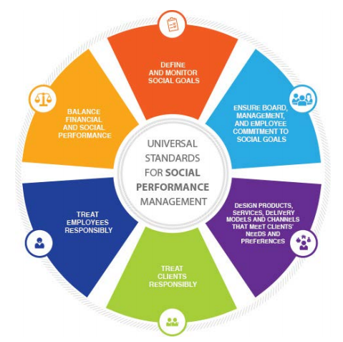
Built on the Universal Standards of Social Performance Management
Alignment with the Social Performance Initiatives.
Truelift
Green
Rural
Gender
Poverty
Notes:
Truelift is a lens on poverty within the USSPM.
We work together with SPTF, Smart, Cerise
SPTF is a guide for the management of any / all social missions. Truelift is how to do / implement a poverty mission and to see the results of that mission.

Slide 5
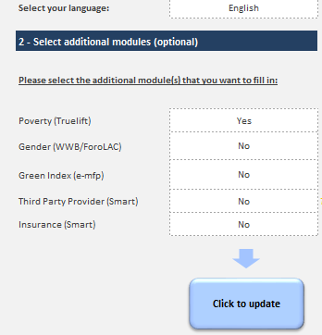
Truelift is the Poverty Module in the SPI4
Download the SPI4 - http://www.cerise-spi4.org/
Select language (Truelift module is available in Spanish, English, or French)
Choose ‘Yes’ for Truelift
Click to Update

Slide 6
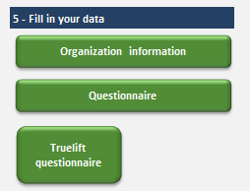
Truelift Questionnaire
5. Click on ‘Truelift Questionnaire’ button in section 5
6. You will be directed to the Summary page
7. Click on ‘Fill in the Truelift indicators’ button

Slide 7
Indicators Worksheet
8. Complete the Indicators worksheet using the dropdowns and Tips.
9. When complete, click on the ‘Pro Poor Scores’ Button

Slide 8
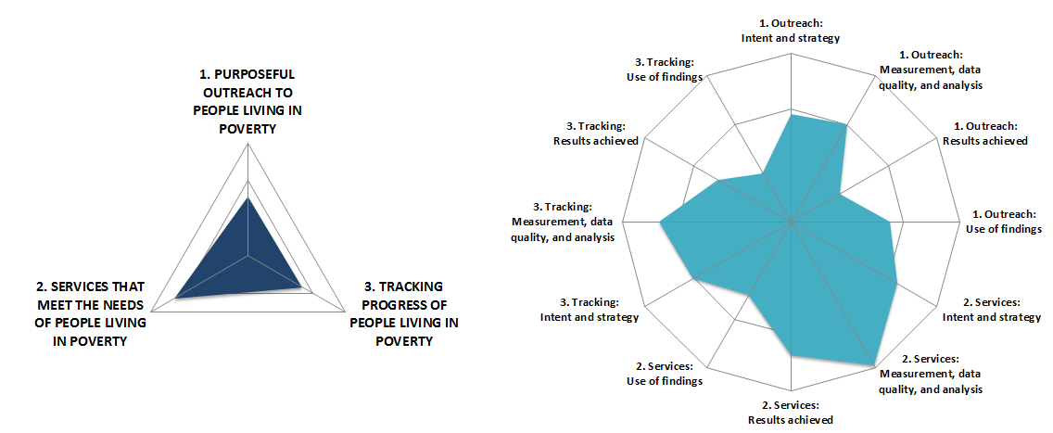
Summary of Results
Notes:
When the tool is completely filled out – return to the summary page / Scores to see the results.
You can review whether your MFI Fully, Partially or Does Not Meet each of the Principles in a chart, on the graphs like these
Strength and weaknesses by principle are in the Triangle and by the categories by principle in the spider chart. Are there greater strengths in the process categories and indicators, weaker results in the results categories and indicators?

Slide 9
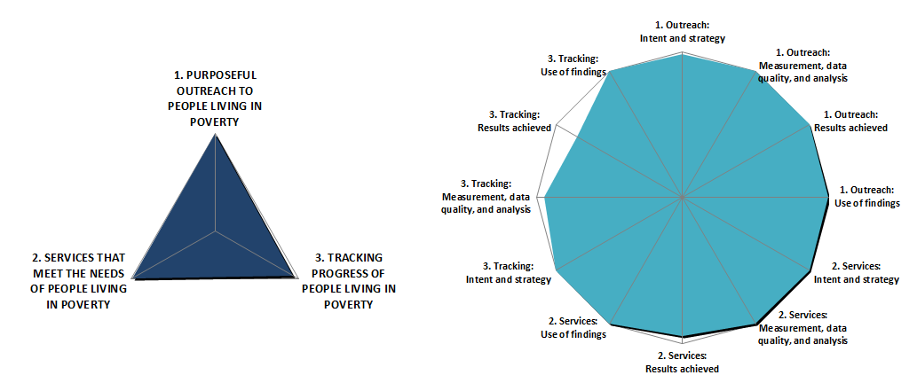
Fundación Paraguaya 2016

Slide 10
Truelift offers a pathway for institutions
Notes:
pathway reflects not only the performance of an MFI’s pro-poor activities, but also the strength of evidence that validates it (come back to who can verify at the end of the training).

Slide 11
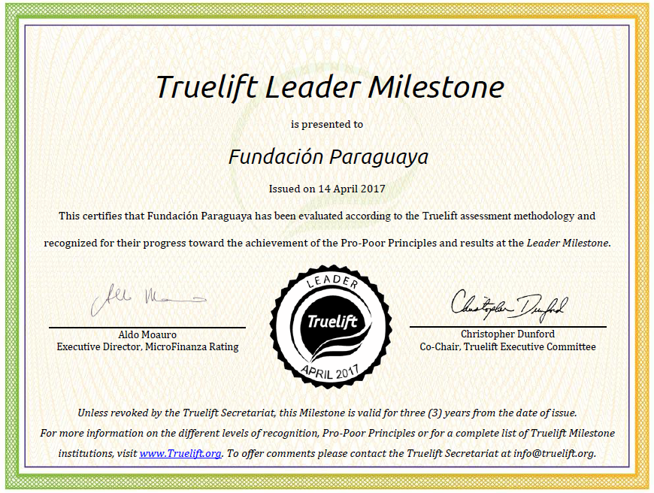

Slide 12
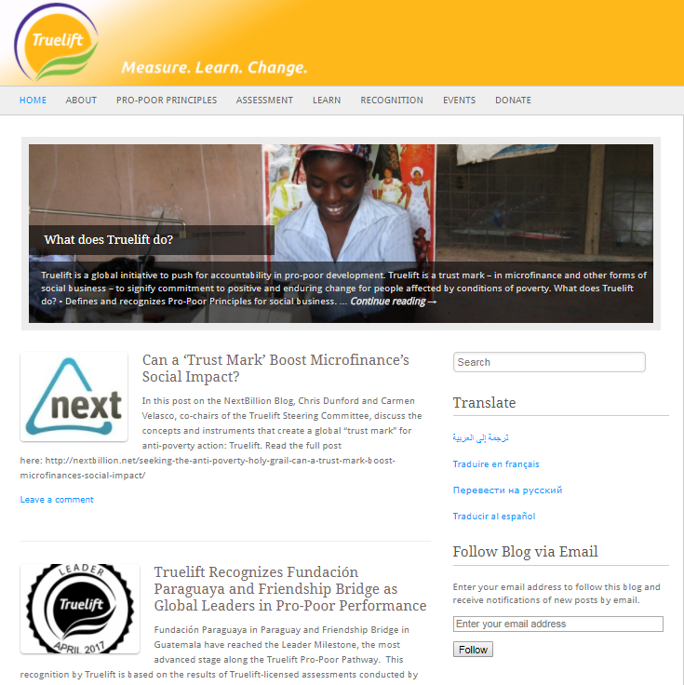
www.truelift.org

