Slide 1
Section 4: Design Products, Services, Delivery Models and Channels That Meet Clients’ Needs and Preferences
Moderator: Cara Forster
With Grameen Koota (India) and MicroSave (India)

Slide 2
Agenda
Review of Section 4 of the Universal Standards
Interview with Sameera B of Grameen Koota, India
Commentary from Sunil Bhat of MicroSave, India
Discussion with Participants

Slide 3
Section 4 of the Universal Standards
Section Title: Design Products, Services, Delivery Models and Channels that Meet Clients’ Needs and Preferences
Rationale: Understanding client needs is key to ensuring that products and services are actually beneficial to clients in progressing toward their business and family goals.
Steps in the Process: 1) understand client needs and preferences, 2) do no harm, 3) use products and services to support social goals.

Slide 4
Section 4: Three Standards
4.a. The institution understands the needs and preferences of different types of clients.
4.b. The institution designs its products and services such that they do not cause harm.
4.c. The institution designs its products and services to benefit clients in line with its social goals.

Slide 5
Standard 4c: Four Essential Practices
4.c.1 Reduce barriers to financial inclusion faced by target clients.
4.c.2 Provides timely access to sufficient money and services that allows clients to reduce their risk and cope with common emergencies.
4.c.3 Creates other benefits for clients by enabling them to invest in economic opportunities and address anticipated household needs.
4.c.4 Complaints information is used to improve the institution’s operations, products, and communications.

Slide 6
Agenda
Review of Section 4 of the Universal Standards
Interview with Sameera B of Grameen Koota
Input from Sunil Bhat of MicroSave, India
Discussion with Participants

Slide 7
Introduction to Grameen Koota
Grameen Koota (“GK”) launched in December 1996:
inspired by the book ‘Give Us Credit’ by Alex Counts
started as a division of the NGO, T. Muniswamappa Trust with seed-capital from Grameen Trust.
transformed in October 2007, to Grameen Financial Services Pvt Ltd. (“GFSPL”), a Non-Banking Finance Company.
GK’s mission is: a) To transform and uplift the lives of poor and low-income families with micro-finance and other development services, and b) To be a sustainable, friendly and trusted provider of affordable and need-based services.

Slide 8
Grameen Koota’s Philosophy
Grameen Koota constantly endeavors to meet the requirements of the clients by offering need-based services.
GK conducts customer surveys and market research on frequent basis
GK used to get constant feedback from field staff about client needs and requirements, and the management was always updated about customer feedback, but in an informal way
Now the system has been restructured so information flows from the customers to GK in a way such that data can be analysed and decisions taken formally.

Slide 9
Grameen Koota’s Target Clients
GK targets poor and low-income households in rural and urban areas across three states in India, where most do not have access to formal credit.
GK has developed products and services to meet the life cycle needs of clients.
GK continuously strives to understand client needs and challenges and offers wide range of financial products and development services to meet these needs.

Slide 10
Grameen Koota’s Product Diversity
GK offers wide range of products to its clients to reduce their risk and cope with emergencies.
Emergency loan
Savings/Pension
Arogya loan
Festival loan
Medical Loan
Life insurance

Slide 11
Understanding the Life Cycle of Client Needs
GK has categorized its range of financial products into credit for productive purposes, livelihood support, and social welfare products, which are separate from the development services offered.

Slide 12
Grameen Koota’s Customer Feedback Mechanism
We introduced two-prong feedback process:
Clients are interviewed in person face-to-face by our Area Managers on a monthly basis, and
Clients are interviewed over phone on daily basis with the help of a call centre.
The interviews by area managers were initially done once a quarter as pilot and later were regularized to happen on a monthly basis.
The call centre team segments clients into 6 different sub-sets and asks specific sets of questions that are relevant to each segment.

Slide 13
GK’s Grievance Redressal system
Client feedback is collected to gage clients’ understanding of products and procedures as well as clients’ perspectives on GK’s processes and products.
GK conducts customer surveys and market research as frequently as once a month.
As a part of the grievance process, the grievance team proactively collects feedback from different sets of clients on a continuous basis.

Slide 14
Using Customer Feedback to Improve Products and Services
A number of important policy and product decisions have been taken based on the results of client surveys. Examples include:
Surveys repeatedly showed that half of clients demanded home loans. GK now has home loans on a pilot basis in a limited number of branches.
Emergency loans were capped at 2 per group. Due to strong feedback from clients, the number was increased to 50% of the group’s size.
Similarly, festival loans though not of big size, were given only at the branch. Based on the client feedback and exploration of client constraints with commuting to branches, festival loans are now disbursed in the groups.

Slide 15
Client driven product innovation
All GK’s products and services have emerged out of feedback and analysis of the requirements of clients.
With over a decade of experience, GK understands the clients’ requirements, which helps the clients lead a sustainable life and raise their social and economic status significantly.
The water and sanitation loans introduced by GK serve as an example of this approach.

Slide 16
Client Driven Product Innovation
GK is committed to better health for its clients and has introduced various health related programs. The Emergency loan offered by GK aims to support clients in meeting unexpected health related expenditures.
Survey results showed lack of awareness about good hygiene and poor sanitation conditions. Dearth of money to construct toilets was a significant part of the problem. More than 90% of clients were interested in toilet construction if GK were to offer credit to support that purpose.
Notes:
GK was wary of such instances where the health issues were very high and identified the root cause of the problem mainly was in lack of hygiene practices and poor sanitation conditions among its client households.

Slide 17
Product Innovation and Reaching the Target Market
Water and sanitation improvements are different from income generating loans. Residents needed to be convinced to improve health and hygiene.
For training and education, GK developed an NGO subsidiary, Navya Disha, to work with communities throughout the loan development process so they would understand:
The technology/infrastructure,
What they can build with the loan amount, and
How to procure parts, labor, and government approval as needed for the construction of the improvements.
Notes:
GK was aware that merely providing credit would not solve the clients’ problems, but creating awareness was also critical.

Slide 18
Product Innovation and Reaching the Target Market
Home loans are being piloted based for demand assessment.
Many of the products serving emergency or risk reducing purposes (e.g. emergency loan, festival loan, education loan, health cover) were all developed after deep analysis of customer demand and clients’ utilization patterns of monies.

Slide 19
Recommendations for Creation of Demand Driven Products
Each step in the implementation process has to be carefully considered:
alignment with mission,
regulatory framework,
external environment,
partnerships,
client protection,
human resources,
technology requirements, and
product and service delivery etc.

Slide 20
Recommendations for Creation of Demand Driven Products
The process of getting feedback from clients has to be continuous and not a one-time activity.
MFI needs to have an open mind and be very dynamic and flexible in terms of introducing or changing products and processes as a result of this client feedback.

Slide 21
Agenda
Review of Section 4 of the Universal Standards
Interview with Sameera B of Grameen Koota, India
Input from Sunil Bhat of MicroSave, India
Discussion with Participants

Slide 22
Developing and Designing Appropriate Products and Services
29th January 2013

Slide 23
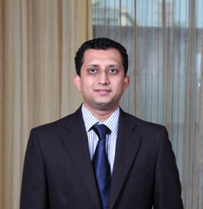
Sunil Bhat
MicroSave is a microfinance consulting firm with offices in Asia, Africa and Latin America.
We work in the areas of technical assistance to microfinance institutions, risk management, responsible finance, value chains, SME and mobile banking.
Sunil Bhat works as a Senior Analyst in MicroSave since last 4 years. He works in the areas of responsible finance, product development, capital advisory and microinsurance.
MicroSave Market-led solutions for financial services
www.microsave.org
Notes:
Change title
23

Slide 24
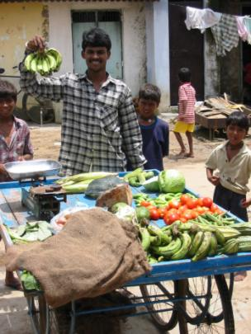
Our Inspiration - “A world in which all people have access to high-quality, affordable, market-led financial services.”
Our Mission - “Strengthening the capacity of financial service providers to deliver market-led financial solutions.”

Slide 25
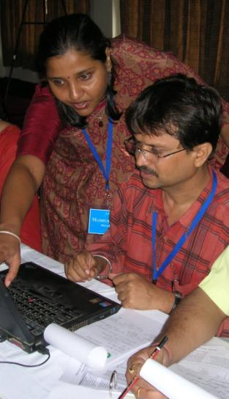
MicroSave – A Quick Overview (1)
Founded 14 years ago in Africa
Started in India in 2006
Offices in Lucknow, Hyderabad, New Delhi, Nairobi, Kampala, Manila, Papua New Guinea and Jakarta
100 staff
Training/TA in microfinance across Asia, Africa and Latin America.
MicroSave toolkits translated into >15 languages and used across the world
Currently supporting >100 MFIs throughout India

Slide 26
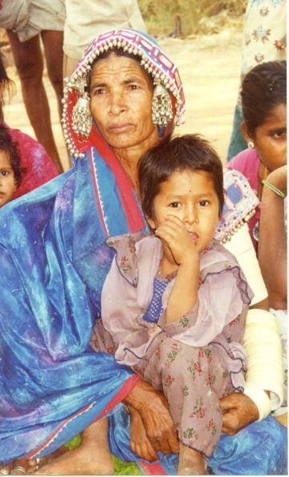
MicroSave – A Quick Overview (2)
Expertise grounded in years of experience working on a variety of organisations and institutional forms
Unique tools and practical solutions that are empowering for the financial institutions and their customers
A history of helping financial institutions achieve very significant growth and a sustainable, positive impact
A market-led approach that has changed the microfinance industry
Support for the development of market-led microfinance across the globe

Slide 27
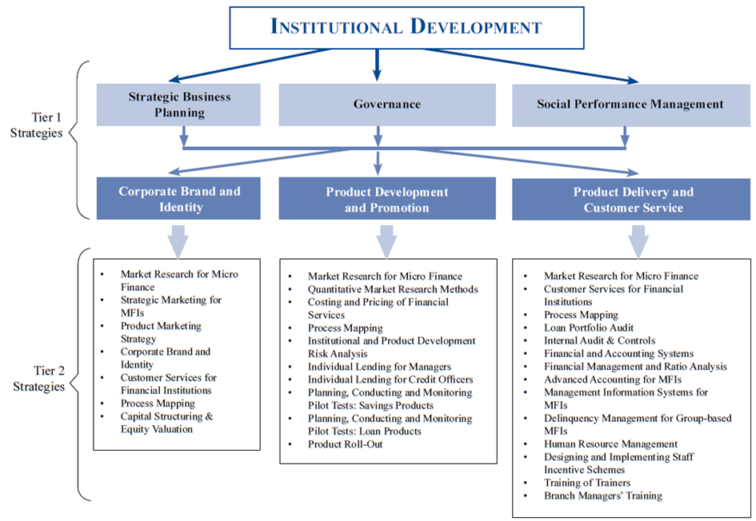

Slide 28
Work with a Variety of Financial Institutions

Slide 29
MicroSave’s Toolkits (1)
Toolkits Available:
Introduction to Microfinance
Strategic Business Planning
Market Research for MF
Costing and Pricing of Products
Pilot Testing - Savings
Pilot Testing - Loans
Roll - Out: Going to scale
Loan Portfolio Audit for MFIs
Quantitative Research
Strategic Marketing
Product Marketing
Corporate Brand and Identity Management
Customer Service
Staff Incentive Schemes
HR Management
Process Mapping
Institutional and Product Risk Management
Training of Trainers
Risk Management for MFIs
Individual Lending for Loan Officers
Governance for MFIs

Slide 30
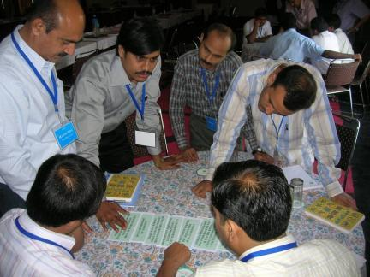
MicroSave’s Toolkits (2)
Toolkits Available (cont.):
Internal Audit and Controls
Basic Financial Accounting
Basic Financial Management & Ratio Analysis
Delinquency Management for Group-based MFIs
Management Information Systems for MFIs
Capital Structuring & Equity Valuation
Social Performance Management
MFI-Out-Of-A-Box
Toolkits Under Development:
Managing Rapid Growth in MFIs
Advanced Accounting
Advanced HR Management

Slide 31
Relationship with various financial institutions
Notes:
CMF: (Uganda) process mapping, e-banking, pilot planning, customer service, strategic marketing
Postbank: (Kenya) staff incentives, e-banking, process mapping, customer service, SBP, product refinement
Teba Bank: (South Africa): Pilot review, customer service
Tanzania postal bank: Product costing, SBP, risk management, staff incentives
FINCA: (Tanzania): process mapping, SBP
Equity bank: (Kenya) : process mapping, staff incentives, product costing, branding
UMU: (Uganda):
Credit indemnity:

Slide 32
Homogenous Clients & Services?
Implicit assumption that microfinance clients are essentially homogenous
Essentially, a “one product fits all” approach continues to dominate the industry worldwide
In reality, the financial service needs of poor people are as diverse and complex as those of richer people
For forward-thinking MFIs, these needs represent opportunities that can be met on a profitable basis

Slide 33
MicroSave’s approach
MicroSave has always been a strong advocate of the fact that one plain vanilla product does not address all needs of the client
We need to have products to meet different lifecycle needs of the poor. Client feedback and inputs play an important role for the success of a product
Tools used:
Focused group discussions
Product attribute ranking
Relative preference ranking
Wealth ranking
Individual interviews

Slide 34
Household Life Cycle needs of clients
Household Formation
Birth (C,S,I)
Death (C, I)
ONGOING FINANCIAL NEEDS
Working Capital (C,S)
Productive Assets (C,S)
Investments (S,C)
Asset protection (I)
Health (C,S,I)
Shocks (C,S,I)
Old Age (I,S)
Education (C,S)
Marriage Ceremony (C,S)
C = Credit
S = Savings
I = Insurance
Notes:
C = Credit
S = Savings
I = Insurance

Slide 35
Market Research & Product Development Process Overview
Research
Issue
Qualitative
Research
Plan
Qualitative
Research:
FGD/PRA
Understanding clients’ needs
Concept
Development
Product
Ready for
Pilot-test
Quantitative
Research:
Prototype
Testing
Refine the
Concept into
a Prototype
Refining/Testing the product prototype
Notes:
This slide provides an overview of the product development process.
Define the problem
->
Understand the clients’ needs (through qualitative research techniques)
->
Develop the product concept/ prototype
->
Test the product prototype (through quantitative research techniques)
->
Get ready to pilot test the product.

Slide 36
Some Prominent Assignments with Grameen Koota
Microenterprise loan product – individual loan product
Financial Stress analysis in the lives of client- market research
M-banking initiative of GK / m-Chek
Housing loan product
Developed product concept for gold based savings product for the poor
Notes:
Other assignments:
MFI based out of North India: worked on the development of a SME based loan product
Filipino MFI: worked on the development of 2 individual lending products
Financial inclusion for a large foreign bank: to check the acceptability of BC services
Large Indian NBFC: Business loan product for working capital need

Slide 37
Social Performance Management Initiatives
MicroSave has been a firm believer in the principles of client protection and responsible finance.
We have a dedicated SPM area within MicroSave.
We use some of the globally accepted frameworks in our SPM assignments, such as Smart Campaign CPP framework, USSPM framework.
We have developed the ServQual tool (based on Smart Campaign’s CPP) and the USSPM MicroSave assessment tool (based on the SPTF USSPM framework).
Notes:
SPM IP* was erstwhile launched and managed by Unitus with support from Michael & Susan Dell Foundation, the Boeing and the Deutsche Bank Foundation. The project mandate has been transferred to MicroSave in September 2010.
We work in India, Bangladesh and Sri Lanka (with 5 organisations in phase I and 6 in phase II).
Overall project objective is to drive the adoption of social performance reporting standards in the microfinance sector & integrating these reporting metrics in the decision making and management of microfinance institutions (MFIs)
We have helped MFIs to develop the following:
Client grievance redressal mechanisms- mechanism of collecting client feedback systematically and to use the feedback in development of products
Client exit feedback mechanism- to collect reasons and to act on it
Client satisfaction survey- to understand the clients requirements, their experience of the service delivered, their feedback on staff etc.
Client data privacy policy – to ensure the safety and security of client data
Developed indicators for MFIs to help them track their social performance
Incorporated PPI into the operational systems of the MFI. The analysis of the PPI data will help the MFIs to understand their client profile in a better way
Hence the overall focus of the SPM IP project was to help MFIs to become more responsible to clients and aim at double bottom line
MicroSave also worked with a few urban MFIs in the Social Microfinance Facility (SMF) project where it implemented things like client data privacy policy, client grievance redressal mechanisms, client satisfaction survey, client exit survey etc. The idea of this project was also to institutionalize SPM into the operations of the MFI

Slide 38
Tewkesbury
Delhi
Lucknow
Hyderabad
Manila
Kampala
Nairobi
Jakarta
Port Moresby
Buenos Aries
MicroSave Offices
MicroSave (India) Head Office: Lucknow Tel: +91-522-2335734 Fax: +91-522-4063773 New Delhi Office: Tel: +91-011-45108373 Hyderabad Office: Tel: +91- 40-23386140 info@MicroSave.net | MicroSave (Kenya Office) Shelter Afrique House, Mamlaka Road, P.O. Box 76436, Yaya 00508, Nairobi, Kenya. Tel: +254-20-2724801/2724806 Fax: +254-20-2720133 Mobile: +254-0733-713380 info@MicroSave.net | MicroSave (Uganda Office) Regency Apartments 30 Lugogo By-Pass P.O. Box 25803 Kampala, Uganda. Tel. +256 312 260 225 Mobile. +256 776 36 5536 info@MicroSave.net | MicroSave (UK Office) The Folly, Watledge Close, Tewkesbury, Gloucestershire GL20 5RJ UK Tel. +44 1684 273729 Mobile +44 796 307 7479 nfo@MicroSave.ne | MicroSave (Manila Office) Unit 402, Manila Luxury Condominiums, Pearl Drive corner Gold Loop, Ortigas Center, Pasig City, Metro Manila, Philippines. Tel: +(632) 477-5740 Mobile: +63-917-597-7789 info@MicroSave.net | MicroSave (Indonesia Office) Jl. Penjernihan I No. 10, Komplek Keuangan - Pejompongan, Jakarta Pusat 10210, Indonesia. Tel: +62 82122 565594 info@MicroSave.net | MicroSave (PNG Office) Corner of Musgrave Street and Champion Parade, Port Moresby, Papua New Guinea. TeleFax No.: +675 321 8823/321 8854 info@MicroSave.net

Slide 39
Thank you
Please visit our website for a wealth of practical guidance in the form of research papers, technical briefs, training toolkits and videos
They are all freely downloadable
www.microsave.org

Slide 40
Agenda
Review of Section 4 of the Universal Standards
Interview with Sameera B of Grameen Koota, India
Input from Sunil Bhat of MicroSave, India
Discussion with Participants

Slide 41
Where to Find More Resources
A summary of the Universal Standards (new and improved format!): http://www.sptf.info/images/designed%20usspm%20manual%2010%2015%2012.pdf
The presentation and recording of this session: http://www.sptf.info/online-trainings/universal-standards-implementation
Resource Library for the Universal Standards of SPM: http://www.sptf.info/spmstandards/standards-resource-library

Slide 42
Examples from SPTF’s Resource Library
Building Customer Loyalty, authored by CGAP and USAID with contributions from many microfinance institutions (global research)
Drawing on experiences of many MFIs, including ABA (Egypt), BRAC (Bangladesh), CERUDEB (Uganda), FINCA Kyrgyzstan, and PRIDE (Tanzania), this extensive guide breaks down the elements of customer loyalty in a useful way and provides concrete tools at each step.
SEEP-AIMS tool: Use of Loans, Profits, and Savings over Time, authored by SEEP (research contributions from MFIs in Bolivia, Eastern Europe, Honduras, Mali, Peru, the Philippines, among others)
See Chapter 6 in this detailed guide—written by and for practitioners—to explore a useful tool for understanding loan use over time.
Case study: How can you make sure you're using client feedback effectively?, AMK (Cambodia) case study in Imp-Act Consortium's SPM Resource Guide
See page 142 in Imp-Act Consortium's SPM Resource Guide for a case study on AMK, which learned to analyze client feedback carefully after it did market research on what clients wanted and heard strong demand for larger loans, only to realize that the wealthier clients were being vocal about their desires whereas poorer clients were being silent. Read all of Chapter 8 in this guide, "Client Service Issues" (beginning on page 135), for a good general reference.

Slide 43
Thank you for your participation!
We invite you to join us in February for the next session in the series, which will be about
Section 5 of the Standards: Treat Employees Responsibly.

