Slide 1
Section 2: Ensure Board, Management, and Employee Commitment to Social Goals
With Mario Medina of Mibanco, Peru and Mónica French of Compartamos, Mexico

Slide 2
Agenda
Review of Section 2 of the Universal Standards
Interview Mario Medina, Mibanco, Peru
Interview Mónica French, Compartamos, Mexico
Discussion with Participants

Slide 3
Section 2 of the Universal Standards
Section Title: Ensure Board, Management, and Employee Commitment to Social Goals
Rationale: An institution’s social strategy is only strong if the Board and all employees understand and uphold it.
Three stakeholders: 1) Board members, 2) Senior managers, 3) All other employees
Notes:
Section 2 is called “Ensure Board, Management, and Employee Commitment to Social Goals.” You’ll remember that Section 1 of the Standards advises that MFIs should have a social strategy that defines their mission, target clients, social goals, social targets, and social indicators.
Section 2 looks at how that social strategy is carried out by the Board, the management, and other employees.

Slide 4
The standards in Section 2
2a- Members of the Board of Directors are committed to the institution’s social mission.
2b- Members of the Board of Directors hold the institution accountable to its social mission and social goals.
2c- Senior management sets, and oversees implementation of, the institution’s strategy for achieving its social goals.
2d- Employees are recruited, evaluated, and recognized based on both social and financial performance criteria.
Notes:
the standards are broad statements that describe what the institution should achieve. The real guidance is found in the essential practices, which describe how an institution should fulfill the standard. So let’s look at the essential practices for each of these four standards.

Slide 5
Standard
2a- Members of the Board of Directors are committed to the institution’s social mission.
Essential Practices
Provide Board with an orientation on the social mission and goals, and the Board’s responsibilities for managing social performance, and confirm that each member agrees. Requires Board members to adhere to the institution’s code of ethics.
Notes:
First, the institution should provide the Board with an orientation on the social mission and goals, and the Board’s responsibilities for managing social performance, and confirm that each member agrees. This means that by the end of their orientation, each Board member should understand what the institution is trying to achieve socially, they know their particular role for managing that social performance (and we’ll talk about those roles in standard 2b), and that they formally agree to these things, whether that means signing something, giving verbal agreement, etc.
The institution should also require Board members to adhere to the institution’s code of ethics. So in the same way that all of the employees of the institution are asked to adhere to the Code of Ethics, so should be Board.
So these are the two essential practices that describe how the members of the Board are committed to the institution’s social mission.

Slide 6
Standard
2b- Members of the Board of Directors hold the institution accountable to its social mission and social goals.
Essential Practices
Board reviews SP data, including: mission compliance, performance results, HR policy, SP related risks, client protection practices, growth, and profit allocation. Board oversees the institution’s strategy, taking into account both social and financial goals. Board uses SP criteria when evaluating the performance of the CEO/Director. Board prevents institutional mission drift during changes in ownership structure and/or legal form (e.g., transformation). CPP that applies A written code of business ethics defines organizational values and the standards of professional conduct expected of all employees. The code of ethics has been reviewed and approved by the Board. (Client Protection Principle 5)
Notes:
After the institution ensures that they have a committed Board, they need the Board to hold the institution accountable to its social mission and social goals, which is standard 2b.
The essential practices that describe how a Board does this.
First the Board reviews SP data, including: mission compliance, performance results, HR policy, SP related risks, client protection practices, growth, and profit allocation. These are all things that the Board should be looking at on a regular basis.
Board oversees the institution’s strategy, taking into account both social and financial goals. So instead of just managing the institution’s financial goals, the Board must oversee how and whether the institution is achieving its social goals as well.
Board uses SP criteria when evaluating the performance of the CEO/Director. This means that when they evaluate the director’s performance, they look at whether the institution is achieving it’s social targets, for example client retention targets, targeting of women or rural people, change in clients’ savings—whatever it is that the institution has decided on as its social targets, these should be a part of the evaluation of the director/CEO.
Board prevents institutional mission drift during changes in ownership structure and/or legal form (e.g., transformation). This means that if the institution is going through transformation, a change in ownership, or a similar situation where there’s risk for mission drift, they put measures in place to reduce this risk.
And finally, the Client Protection Principle that applies. As many of you know, the Smart Campaign’s certification standards are embedded within the Universal Standards, and we’ve made it very obvious which of the essentials practices are also CP standards, by highlighting them within the document. So the CP standard that applies comes from CPP #5—Fair and Respectful Treatment of Clients, and it states that a written code of business ethics defines organizational values and the standards of professional conduct expected of all employees. The code of ethics has been reviewed and approved by the Board.
So these essential practices, taken together, describe how the Board holds the institution accountable to its social mission and social goals.

Slide 7
Standard
2c- Senior management sets, and oversees implementation of, the institution’s strategy for achieving its social goals.
Essential Practices
Sr. management integrates SP goals into business planning, making strategic and operational decisions based on how they effect both social and financial performance. Sr. management analyzes SP data, incl. data on client-level outcomes, to compare the institution’s actual performance against its stated social targets. Senior managers consider and take action to avoid social performance related risks (e.g., reputation risk, mission drift). CEO/Director holds senior managers accountable for making progress toward the institution’s social goals (e.g., reaching target clients, successful implementation of client protection practices). CP standard that applies: (CPP 2) Senior managers and the Board are aware of and regularly monitor risk of client over indebtedness.
Notes:
Standard 2c states that senior management sets, and oversees implementation of, the institution’s strategy for achieving its social goals. Again, we discuss the requirements for the institution’s strategy in Standard Section 1, so if you haven’t reviewed that, I encourage you to do so.
The essential practices describe how sr. management oversees the social strategy.
First, senior management integrates the institution’s social performance goals into business planning, making strategic and operational decisions based on both their social and financial performance implications. This is similar to what we said the Board should do—sr. management should consider both the social and financial implications of all decisions, for example decisions on new products or delivery mechanisms, or decisions on where to set growth targets.
Senior management analyzes social performance data, including data on client-level outcomes, to compare the institution’s actual performance against its stated social targets. Sr. management should use concrete social data, collected from the field, to compare the institution’s social targets (which we discuss in section 1) to the institution’s real performance—the same way that they would do this for financial performance targets.
Senior managers consider and take action to avoid social performance related risks (e.g., reputation risk, mission drift). This means that managers are vigilant about watching for SP risks, they define what the potential risks are (for example, a risk would be high staff growth without adequate resources for training them) and carefully monitor these risks.
The CEO/Director holds senior managers accountable for making progress toward the institution’s social goals (e.g., reaching target clients, successful implementation of client protection practices). In the same way that the Board should hold the director accountable for the institution’s social achievements, so too should the director hold her leadership accountable to specific social performance targets. [make a plug for module 2 of the SPM Essentials course if there’s time]
The client protection standard that applies is that senior managers and the Board are aware of and regularly monitor risk of client over indebtedness. So we’ve already said that the Board and managers should monitor SP related risks, and the Smart Campaign is particularly concerned about the risk of client over-indebtedness.

Slide 8
Standard
2d- Employees are recruited, evaluated, and recognized based on both social and financial performance criteria.
Essential Practices
Screen job candidates for their commitment to the institution’s social goals, and ability to carry out SP related responsibilities. Evaluate employees on how they perform both their SP and FP responsibilities. CP standards that apply: (CPP 5) Code of Ethics provides clear standards of professional conduct are expected of all employees, and especially acceptable and unacceptable debt collection practices. Employees are recruited and trained in line with the code of ethics. Employee productivity targets and incentive systems value portfolio quality at least as highly as other factors. Employees are evaluated and incentivized on ethical behavior.
Notes:
So we’ve talked about standards for the board and standards for managers, we also have a standard that applies to other employees. Standard 2d states that employees are recruited, evaluated, and recognized based on both social and financial performance criteria.
The institution screens job candidates for their commitment to the institution’s social goals, and ability to carry out SP related responsibilities. Examples of social performance responsibilities are customer service, social data collection, and client training.
The institution evaluates employees on how they perform both their SP and FP responsibilities. This means that if an employee has SP responsibilities, they are part of how the employee is evaluated. So for example, a loan officer would be evaluated on their portfolio growth, but also on the accuracy of the social data she collects.
There are 4 client protection standards that apply here, and they all correspond with CPP 5, which is fair and ethical treatment of clients.
The institution has a Code of Ethics that provides clear standards of professional conduct expected of all employees, and especially acceptable and unacceptable debt collection practices (CPP5).
Employees are recruited and trained in line with the code of ethics. (CPP5) This ensures that the code of ethics and the collections policies are really understood and practiced by employees.
Employee productivity targets and incentive systems value portfolio quality at least as highly as other factors (CPP5). We’ve already said that employees should be evaluated on their SP related responsibilities, and this takes that one step further by saying that targets and incentives must balance portfolio growth with portfolio quality, so that employees are only rewarded for portfolio growth if portfolio quality is also high.
Employees are evaluated and incentivized on ethical behavior. Managers and supervisors review ethical behavior, professional conduct, and the quality of interaction with customers as part of employee performance evaluations.
So these are the essential practices that describe how employees are recruited, evaluated, and recognized based on both social and financial performance criteria.

Slide 9
Interview with Mario Medina of Mibanco, Peru Focus on Standard 2b—Members of the Board of Directors hold the institution accountable to its social mission and social goals.

Slide 10
How does Mibanco ensure that Board members are aligned with the mission of the bank?
Board = Grupo ACP (ACP Group) and representatives of Triodos Bank and Acción International.
Grupo ACP (founded Mibanco) had a mission similar to that of Mibanco.
Triodos Bank and Acción International have strong social commitment.
Notes:
Mibanco’s Board of Directors is composed of members of Grupo ACP (ACP Group) and representatives of Triodos Bank and Acción International. The members of Grupo ACP, the institution that founded Mibanco, had a mission similar to that of Mibanco before it become a financial entity. Triodos Bank and Acción Internacional are similar to Mibanco in their social commitment.

Slide 11
Does Mibanco provide orientation/ training to your Board members on SPM?
Training platforms.
Internships with other institutions (Compartamos, Triodos Bank, and others).
Regular discussions on: the national socioeconomic reality, the Mibanco Scorecard, and our social programs.
Notes:
Mibanco provides orientation to its Board of Directors through diverse activities such as training platforms, internships with other institutions (internships with Compartamos, visits to Triodos Bank, and more), and discussions on the national socioeconomic reality. Some of the activities and documents developed by the Social Assets division, such as the Scorecard, the Microjustic Program, the Miconsultor Program, and online courses, are also the topics of focus of Board discussions.

Slide 12
How often does the Board review social performance data and what do they review?
Quarterly
The “Triple P” Scorecard: People, Planet, Profit – it examines the bank’s social, economic and environmental performance
Scores Mibanco on: Financial Inclusion, Smart Banking (incl. client protection), Human Capital Development, Social and Environmental Management, and Corporate Governance
Notes:
The fundamental information the Board receives are the Triple P Quarterly on People, Planet, Profit - Social, Economic and Environmental Performance. This report, as you know, includes: Financial Inclusion, Smart Banking, Human Capital Development, Social and Environmental Management and Corporate Governance.

Slide 13
What types of social performance decisions does your Board make with the data provided?
Whom we should target
Products and services
Examples: the Board is in charge of decisions regarding the “Salta” client training program, decisions on financing social programs like Microjustice and Miconsultor.
Notes:
The Board makes decisions related to Mibanco’s target market and the types of products it provides to its customers. For example, the Board is in charge of decisions regarding the “Salta” training program for clients and potential clients, decisions to finance programs like Microjustice and Miconsultor for the benefit of our clients.
Microjustice (http://www.upsides.com/2012/09/04/access-to-justice/)
Miconsultor: (http://www.grupoacp.com.pe/boletin_sumando_dic2011/ingles/el_grupo_al_dia.html)

Slide 14
What are the “hot” issues in your boardroom, related to social performance?
Whether the “Triple P” Scorecard indicators are really improving our institutional culture, or if they are only creating minimal change.
Notes:
The hottest issue right now is whether the “Triple P” Scorecard indicators are really improving our institutional culture, or if they are only creating minimal change.

Slide 15
Interview with Mónica French of Compartamos, Mexico Focus on Standard 2d—Employees are recruited, evaluated, and recognized based on both social and financial performance criteria.

Slide 16
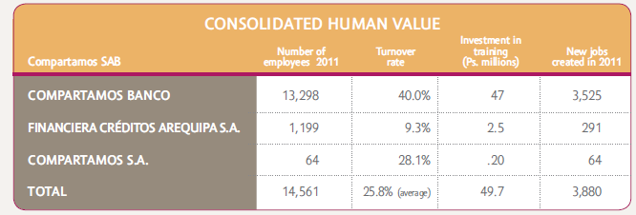
Compartamos’ Human Resources
2012: second place in the Mexico ranking of the ¨Great Places to Work Institute¨ and listed as one of Mexico’s Best Companies for Women to Work.
Six institutional values (“mystica”) have been adopted as part of the organizational culture: Person, Service, Responsibility, Passion, Teamwork and Profitability.
PYXIS: Integral service model for training inspiring leaders who, through their experience and willingness to serve others, achieve self awareness while generating social, economic and human value.

Slide 17
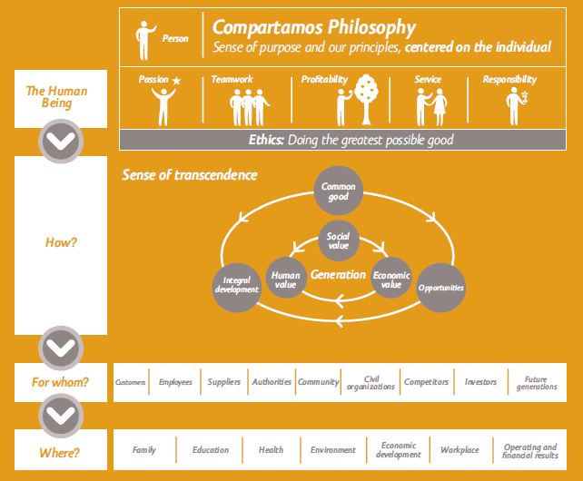
Why is it important to select employees who share Compartamos’ social mission?
Sustainability Model
Mission: Eradication of financial exclusion.
It´s a natural feedback loop for us. Finding the right talent that is committed to our social mission allows us to better serve our customers by creating development opportunities for the greatest number of people in the BOP in the shortest time possible.

Slide 18
Can you describe the recruitment and selection process for employees?
Who we recruit: Recruiting the right individuals is key. Therefore, we assess not only functional competencies, but also the candidate’s alignment with our six core values.
How we recruit: All candidates must take a test that assesses their integrity and alignment to the institution’s ethics. Results are then reviewed by hiring managers before making any job offers.
Trial period: New employees join “under contract” for 3 months. This time gives them a chance to learn and live the values of the organization before joining the institution as full time employees.

Slide 19
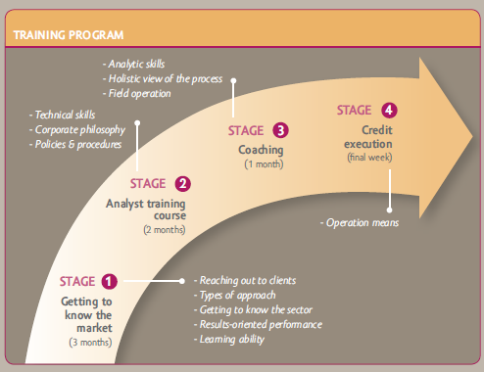
What training do employees receive, to ensure that they understand the contents of the Code and how to put it into practice?
Through its formation program for young talent, called CREAR, we provide our employees with the training necessary for both corporate and personal growth.

Slide 20
What kind of training…? (continued)
Compartamos’ Code of Ethics (established in 2004) is a “living document” frequently reviewed by employees and Board of Directors and updated once a year.
When a new employee joins the institution he/she must take an online exam about the Code of Ethics; when passed the employee becomes certified. Annually, all employees as well as the Board are required to be recertified.
The induction program consists of an on-line course and a live session with the ¨Guardian of Principles¨ which includes a symbolic act of commitment and certification in the Code of Ethics.
We also conduct an annual Internal Client Service survey to assess how each area is servicing other areas in the fulfillment of their projects while preserving our Code of Ethics.

Slide 21
What social performance criteria are included on employees’ balanced scorecards?
Compartamos Banco has created a strong institutional culture with systems and processes in place that guarantee mobilization of all staff towards social goals.
Compartamos uses the Balanced Scorecard method that is the strategic planning model to help define the actions we should carry out in the short term to help accomplish our sense of purpose in the long term (mission and vision).
We employ the Scorecard across each department (ex. Finance, HR, Mktg) that must align their objectives with key indicators across four key dimensions:
Leadership & Training
Internal Processes
Clients
Financial

Slide 22
Discussion with Participants

Slide 23
Where to find resources
SPM Resource Library for the Universal Standards: http://www.sptf.info/spmstandards/standards-resource-library
This presentation and audio recording: http://www.sptf.info/sp-task-force/online-learning-events#1

Slide 24
Join us for Section 3
Topic: Treating Clients Responsibly
Date: Second week of December, date TBA

