Slide 1

Section 6: Balance Social and Financial Performance
The Universal Standards Implementation Series
Today’s speakers: Emmanuelle Javoy, Planet Rating, Dina Pons, Incofin, and Lisa Sherk, Blue Orchard
April 3, 2013

Slide 2
Agenda
Review of Section 6 of the Universal Standards
Interview with Dina Pons from Incofin
Interview with Emmanuelle Javoy from Planet Rating
Update from Lisa Sherk on the AVOID Working Group
Discussion with Participants

Slide 3
Section 6 of the Universal Standards
Section Title: Balance Social and Financial Performance
Rationale: An institution’s financial decisions and results should reflect their social goals.
Four standards:
  6a- Growth
  6b- Financing structure & profits
  6c- Prices & profits
  6d- Executive compensation

Slide 4
6a- Growth rates are sustainable and appropriate for market conditions, allowing for high service quality.
Essential Practices
Set sustainable target growth rates, considering both internal factors (e.g., staffing, information systems, financing) and external factors (e.g., competition, market saturation, client over-indebtedness). Manage the risks associated with growth by: 1) assessing market conditions to ensure that neither sustainability nor client wellbeing are compromised by pursuit of short-term growth, and 2) setting and verifying compliance with growth related policies across all departments/branches. Examine quarterly growth rates for all branches/regions, not just the overall annual rates and use a monitoring system to identify unexpected and unsanctioned growth. Monitor whether internal capacity (e.g., MIS, risk management, employee training) is keeping pace with institutional growth in number of clients and amount of loans and deposits, and increase that capacity as needed.

Slide 5
6b- The institution’s financing structure is appropriate to a double bottom line institution in its mix of sources, terms, and desired returns.
Essential Practices
Ensure alignment with investors on 1) the use of the institution’s returns, and 2) the profitability expectations of the institution. Ensure alignment with investors on planned time horizons for investment, and exit strategies are aligned with the institution’s social goals and stage of development. Consider the total cost of capital when deciding on a financing structure in order to understand what cost would be passed on to the client. Protect client savings and cash collateral. Invest a portion of profits to increase value to customers, such as lowering interest rates or adding or improving products and services.

Slide 6
6c- Pursuit of profits does not undermine the long-term sustainability of the institution or client well-being.
Essential Practices
Set responsible prices for products and services (e.g., effective interest rates on loans, fees for remittances, insurance premiums), meaning that prices are: Market-oriented and competitive within the country context; and Allow the institution to earn a rate of return to support operations and grow The Board monitors whether the institution’s pricing levels for all products and services are consistent with the institution’s policies on returns. Establish a loan-officer-to-client ratio that promotes high service quality for clients.

Slide 7
6d- The institution offers compensation to senior managers that is appropriate to a double bottom line institution.
Essential Practices
Transparently disclose compensation (defined as salary, benefits, bonuses, stock options, and cash value of perquisites) to regulators, donors, and investors, upon request. Calculate the difference between the average compensation of top level executives (e.g., CEO, CFO) and field employees, and evaluate whether this spread is consistent with the institution’s mission, social goals, and commitment to treat employees responsibly.

Slide 8
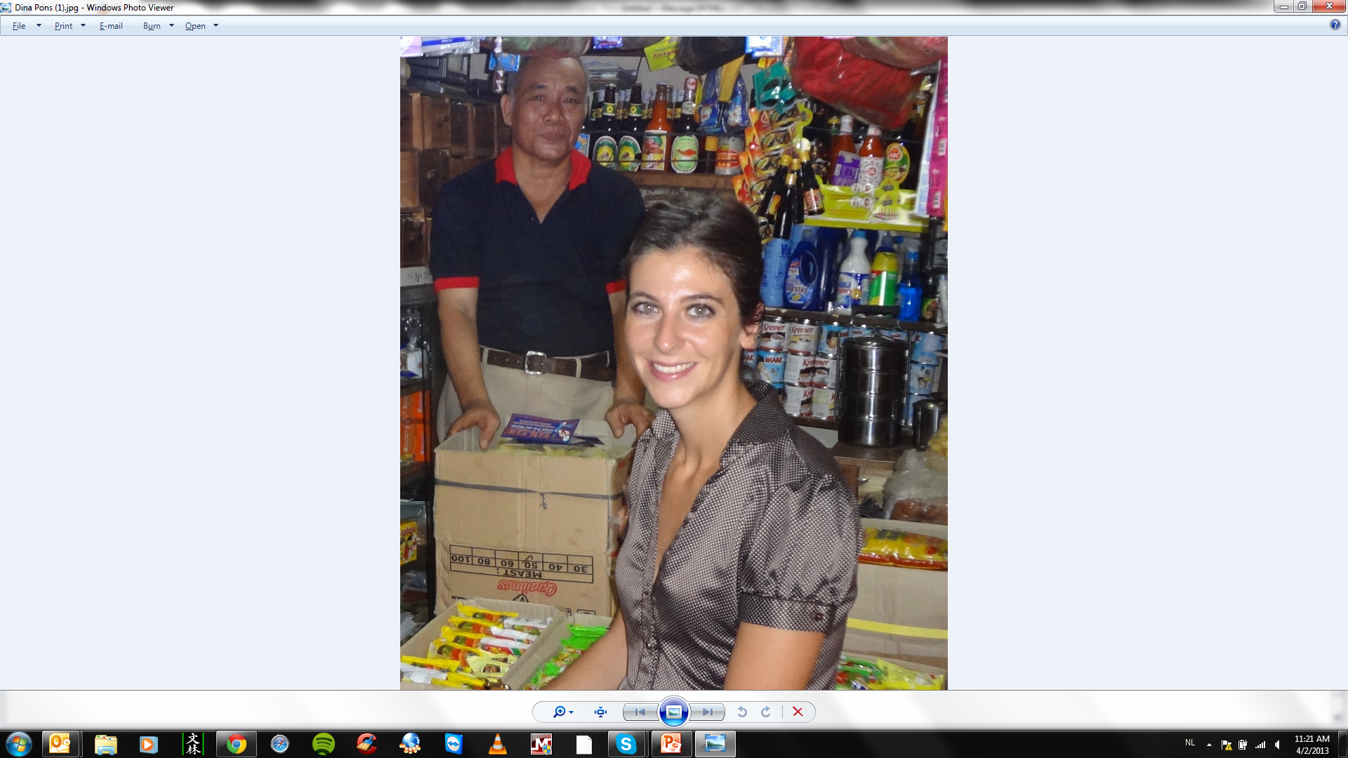
Interview with Dina Pons, Incofin
Standard 6a- Growth rates are sustainable and appropriate for market conditions, allowing for high service quality.

Slide 9
How does Incofin look for when assessing an FI’s growth rates?
First level of analysis:
  Level of microfinance services penetration in the country/provinces/districts of where the MFI is located.
  Level of multiple borrowing, presence of a credit bureau, etc.
  Level of growth rates and type of product offering, average loan size of the main microfinance providers.
Second level analysis:
    Past and present levels of growth rates of the MFI.
    Projected growth rates of the MFI (conversation with MT and BOD).
  Third level analysis:
    Refined analysis per branch, per quarter, per region, etc
    Analysis of internal capacities (MIS, risk management, credit underwriting policies, delinquency management, etc).
    Analysis of HR: middle managers, compliance culture, incentive schemes, etc.

Slide 10
When assessing an investee’s growth rates, what do you consider “responsible” vs. “irresponsible?
Due diligence tool rewards average annual growth rates standing between 25% to 75% depending on the factors previously described.
  Start-up MFIs in virgin markets with growth rates at 150%
  Mature MFIs in highly penetrated markets with growth rates at 25%
  Young and fragile MFIs with limited internal capacities in low penetrated market with growth rates at 45%.
Responsible growth rate analysis cannot be captured by one ratio, but shall take into account several factors.
Need for consolidated data and country level analysis for investors to use as reference grid ? (Mimosa, OID studies, etc).
Notes:
These are the reasons why we treat employees responsibly:
-It creates satisfied employees who in turn offer better services thereby enabling the organisation to have a competitive edge.
-Employees are our contact with our clients. Most clients are low-income women and we need to maintain the focus on them.
-We need a committed workforce. Our employees are our biggest asset.
-We hire internally and keep employees for 20+ years. We want to retain and keep them satisfied. This will differentiate us from other employers.
-We do feel unique because in a sector-wide survey last year, KWFT came out as the second-most preferred employer in Kenya, as voted on by employees. A satisfied workforce equals a satisfied client base. We have 2300 employees—only about 150 are at headquarters, the rest are out in the field, which is rural.
-We consider each employee’s individual needs and try to reach a compromise on various issues (e.g. marital, health and management development from within).
-Emphasis is on internal relationships to ensure external relationships with clients are well done.
-Competitive microfinance market—institutions have to work to attract and maintain their workforce.

Slide 11
Do investors have a responsibility to assess market penetration when making investment decisions?
For each individual investment:
  There is a responsibility to assess market penetration before investing.
  For debt investments: there is a responsibility to monitor and discuss market penetration with the management team during the investment
  For equity investments: there is a responsibility to set reasonable growth rates at the BOD level and in agreement with the whole operation staff and management.
For markets as a whole:
  There is a responsibility to assess market penetration before investing.
  Need for collaborative work among investors (Kyrgyzstan group, AVOID, OID study)
  Example of the OID study conducted in Cambodia.
    Co-financed by Blue Orchard, Incofin IM, Oikocredit
    Cooperation of 8 leading Cambodian MFIs
    Publication date : April 5th
Notes:
These are the reasons why we treat employees responsibly:
-It creates satisfied employees who in turn offer better services thereby enabling the organisation to have a competitive edge.
-Employees are our contact with our clients. Most clients are low-income women and we need to maintain the focus on them.
-We need a committed workforce. Our employees are our biggest asset.
-We hire internally and keep employees for 20+ years. We want to retain and keep them satisfied. This will differentiate us from other employers.
-We do feel unique because in a sector-wide survey last year, KWFT came out as the second-most preferred employer in Kenya, as voted on by employees. A satisfied workforce equals a satisfied client base. We have 2300 employees—only about 150 are at headquarters, the rest are out in the field, which is rural.
-We consider each employee’s individual needs and try to reach a compromise on various issues (e.g. marital, health and management development from within).
-Emphasis is on internal relationships to ensure external relationships with clients are well done.
-Competitive microfinance market—institutions have to work to attract and maintain their workforce.

Slide 12

Interview with Emmanuelle Javoy, Planet Rating
Standard 6a- Growth rates are sustainable and appropriate for market conditions, allowing for high service quality.

Slide 13
When rating an FI, which growth-related factors do you assess?
Quality of the assessment by the MFI of the capacity of its market
Internal capacity to manage the training of staff
MIS that can adapt
Internal audit function that can keep up with growth. Audit plan that oversamples new branches
Performance analysis that takes into account the fact that PAR is not an efficient measure of portfolio quality when the proportion of “fresh” portfolio is important > analysis by vintages of portfolio needed
Notes:
These are the reasons why we treat employees responsibly:
-It creates satisfied employees who in turn offer better services thereby enabling the organisation to have a competitive edge.
-Employees are our contact with our clients. Most clients are low-income women and we need to maintain the focus on them.
-We need a committed workforce. Our employees are our biggest asset.
-We hire internally and keep employees for 20+ years. We want to retain and keep them satisfied. This will differentiate us from other employers.
-We do feel unique because in a sector-wide survey last year, KWFT came out as the second-most preferred employer in Kenya, as voted on by employees. A satisfied workforce equals a satisfied client base. We have 2300 employees—only about 150 are at headquarters, the rest are out in the field, which is rural.
-We consider each employee’s individual needs and try to reach a compromise on various issues (e.g. marital, health and management development from within).
-Emphasis is on internal relationships to ensure external relationships with clients are well done.
-Competitive microfinance market—institutions have to work to attract and maintain their workforce.

Slide 14
What problems have you seen at the market level, caused by irresponsible growth rates?
In markets where growth rates are either not adapted to the market capacity or to the internal capacity of MFIs, we usually see the development of unhealthy competition (poaching of staff with their portfolio of clients) or marketing techniques (aggressive sales techniques, offer to buy-out existing loans) which can create a downward spiral for all actors
Notes:
These are the reasons why we treat employees responsibly:
-It creates satisfied employees who in turn offer better services thereby enabling the organisation to have a competitive edge.
-Employees are our contact with our clients. Most clients are low-income women and we need to maintain the focus on them.
-We need a committed workforce. Our employees are our biggest asset.
-We hire internally and keep employees for 20+ years. We want to retain and keep them satisfied. This will differentiate us from other employers.
-We do feel unique because in a sector-wide survey last year, KWFT came out as the second-most preferred employer in Kenya, as voted on by employees. A satisfied workforce equals a satisfied client base. We have 2300 employees—only about 150 are at headquarters, the rest are out in the field, which is rural.
-We consider each employee’s individual needs and try to reach a compromise on various issues (e.g. marital, health and management development from within).
-Emphasis is on internal relationships to ensure external relationships with clients are well done.
-Competitive microfinance market—institutions have to work to attract and maintain their workforce.

Slide 15
What is MIMOSA and how will it help the industry understand and prevent irresponsible growth and client over-indebtedness?
MIMOSA is a model to estimate the credit market capacity
It is based on data from Global Findex
Analysis shows that the use of credit for formal financial institutions is correlated to
  HDI (Human Development Index)
  Savings at formal financial institutions
  Use of semi-formal borrowing sources (employer, private lender, etc.)
We assign a score to each market based on the comparison between the predicted credit market capacity and the current use of credit.
A score of 5 identifies countries where the current use of credit is at least twice the predicted level
Notes:
These are the reasons why we treat employees responsibly:
-It creates satisfied employees who in turn offer better services thereby enabling the organisation to have a competitive edge.
-Employees are our contact with our clients. Most clients are low-income women and we need to maintain the focus on them.
-We need a committed workforce. Our employees are our biggest asset.
-We hire internally and keep employees for 20+ years. We want to retain and keep them satisfied. This will differentiate us from other employers.
-We do feel unique because in a sector-wide survey last year, KWFT came out as the second-most preferred employer in Kenya, as voted on by employees. A satisfied workforce equals a satisfied client base. We have 2300 employees—only about 150 are at headquarters, the rest are out in the field, which is rural.
-We consider each employee’s individual needs and try to reach a compromise on various issues (e.g. marital, health and management development from within).
-Emphasis is on internal relationships to ensure external relationships with clients are well done.
-Competitive microfinance market—institutions have to work to attract and maintain their workforce.

Slide 16
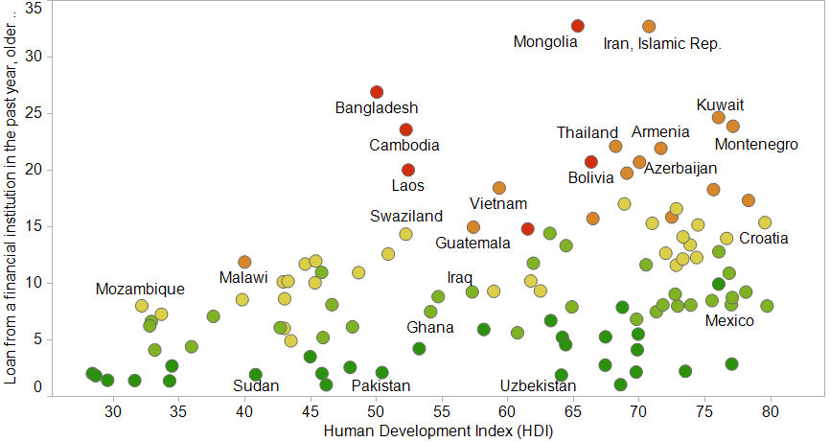
MIMOSA

Slide 17
Update from the Avoiding Over-Indebtedness Working Group

Slide 18
Discussion with Participants

Slide 19
Where to find resources
SPM Resource Library for the Universal Standards: http://sptf.info/spmstandards/standards-implementation-resources
This presentation and audio recording: http://sptf.info/online-trainings/universal-standards-implementation

