Slide 1
Dimension 4: Treat Clients Responsibly
With Gulshan Jumayeva of FINCA Azerbaijan and Leah Wardle of the SPTF

Slide 2
Agenda
Review of Dimension 4 of the Universal Standards
Interview with Gulshan Jumayeva of FINCA Azerbaijan
Q&A with participants
SPTF Presenter: Leah Wardle

Slide 3
Dimension 4 of the Universal Standards
Section Title: Treat Clients Responsibly
Relationship with the Smart Campaign: The entire contents for this section comes from the Smart Campaign’s client protection standards.
Rationale: Institutions that seek to bring benefits to their clients must ensure that they “do no harm.”

Slide 4
The standards in Dimension 4
4a—Prevention of over-indebtedness
4b—Transparency
4c—Fair and Respectful Treatment of Clients
4d—Privacy of Client Data
4e—Mechanisms for Complaints Resolution
Notes:
the standards are broad statements that describe what the institution should achieve. The real guidance is found in the essential practices, which describe how an institution should fulfill the standard. So let’s look at the essential practices for each of these four standards.

Slide 5
Standard
4a. Prevention of Over-indebtedness
Essential Practices Summary
Conduct appropriate client repayment capacity analysis before disbursing a loan. Incentivize quality loans. Use credit bureau and competitor data, when feasible in the local context. Ensure senior management and the board are aware of and concerned about the risk of over-indebtedness. Use the internal audit department to check that policies to prevent over-indebtedness are applied. Avoid dangerous commercial practices.

Slide 6
Standard
4b. Transparency
Essential Practices Summary
Fully disclose cost and non-cost information. Communicate proactively with clients in a way that clients can easily understand. Use a variety of disclosure mechanisms. Leave adequate time for client review and disclose information at multiple times. Provide accurate and timely account information.

Slide 7
Standard
4c. Fair and Respectful Treatment of Clients
Essential Practices Summary
Define in specific detail what you considers to be (in)appropriate debt collection practices. Align HR policies on recruitment and training with fair and responsible treatment of clients. In selection and treatment of clients, do not discriminate inappropriately against certain categories of clients. Expect in-house and third party collections employees to follow the same practices as the institution’s staff. Inform clients of their rights.

Slide 8
Standard
4d. Privacy of Client Data
Essential Practices Summary
Implement a privacy policy and appropriate technology systems. Informs clients about when and how their data is shared and gets their consent.

Slide 9
Standard
4e. Mechanisms for Complaints Resolution
Essential Practices Summary
Make clients aware of how to submit complaints. Train employees to handle complaints. Ensure the complaints resolution system is active and effective. Use client feedback to improve practices and products.

Slide 10
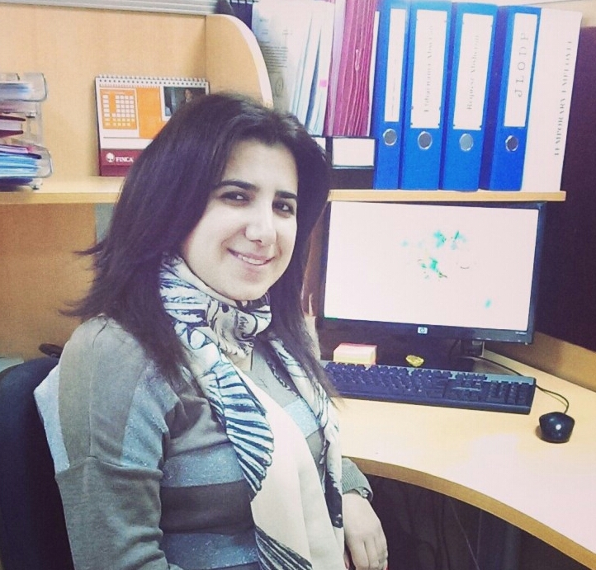
Interview with Gulshan Jumayeva of FINCA Azerbaijan
PR Coordinator, FINCA Azerbaijan

Slide 11
1. Why did FINCA AZ decide to make improvements to its complaints mechanism?
Engagement with the Smart Campaign www.smartcampaign.org
Social mission of the organization--our goal is to provide quality services and treat clients well
To deal with problems before they become unmanageable
To get feedback on our products and services

Slide 12
2. How can clients make complaints/ ask questions?
Hotline and office line calls
Complaints books/suggestions and complaints boxes
Client visits to the offices and official letters

Slide 13
3. What are the most common questions and complaints?
Loan terms and conditions
Loan types – individual and group loans
Payment issues

Slide 14
4. Which employees deal with client questions and complaints?
Initial steps - Client Service Representatives (CSR working within Marketing Department)
CRM Coordinator and Marketing Manager
Within the process of investigation and solution of the problem – Legal department, branch managers, Regional Operations Managers

Slide 15
5. What does FINCA AZ do with the complaints information collected from clients?
Refer it to the relevant branch or responsible officer in accordance with the complaint category
Inform client about the results in 3 days period

Slide 16
6. This is a financial investment—is it worth it, from a business perspective?
Business case benefits:
Increase in client loyalty when clients feel “heard”
A chance to correct problems and retain dissatisfied clients
Building a good reputation in the community
A form of market research—clients give feedback on products and services, allowing us to make adjustments

Slide 17
Where to find more resources on Dimension 4
This presentation and audio recording: http://sptf.info/online-trainings/universal-standards-implementation
The Universal Standards Implementation Guide: Coming Soon!
Universal Standards Resource Library: http://sptf.info/spmstandards/standards-implementation-resources

