Slide 1

Dimension 2: Ensure Board, Management, and Employee Commitment to Social Goals
With Bonnie Brusky of CERISE

Slide 2

Agenda
Review of Dimension 2 of the Universal Standards
Demonstration of the new SPI4 social audit tool
Q&A with Bonnie Brusky, CERISE
SPTF Presenter: Leah Wardle

Slide 3
Dimension 2 of the Universal Standards
Section Title: Ensure Board, Management, and Employee Commitment to Social Goals
Rationale: An institution’s social strategy is only strong if the Board and all employees understand and uphold it.
Three stakeholders: 1) Board members, 2) Senior managers, 3) All other employees
Notes:
Dimension 2 is called “Ensure Board, Management, and Employee Commitment to Social Goals.” You’ll remember that Section 1 of the Standards advises that MFIs should have a social strategy that defines their mission, target clients, social goals, social targets, and social indicators.
Dimension 2 looks at how that social strategy is carried out by the Board, the management, and other employees.

Slide 4
The standards in Dimension 2
2a- Members of the Board of hold the institution accountable to its mission and social goals.
2b- Senior management oversees implementation of the institution's strategy for achieving its social goals.
2c- Employees are recruited, evaluated, and recognized based on both social and financial performance criteria.
Notes:
the standards are broad statements that describe what the institution should achieve. The real guidance is found in the essential practices, which describe how an institution should fulfill the standard. So let’s look at the essential practices for each of these four standards.

Slide 5
Standard
2a- Members of the Board of hold the institution accountable to its mission and social goals.
Essential Practices
The Board gets an orientation on the social mission and goals, and their responsibilities for managing SP. The Board reviews SP data. The Board uses SP data to provide strategic direction. The Board incorporates SPM criteria into its performance evaluation of the CEO. The Board has a documented strategy to prevent institutional mission drift during changes in ownership structure and/or legal form.
Notes:
Let’s look first at standard 2a- Members of the Board of hold the institution accountable to its mission and social goals.
What does this look like in practice? Here’s where we look at the essential practices.
First, the institution should provide the Board with an orientation on the social mission and goals, and the Board’s responsibilities for managing social performance, and confirm that each member agrees. This means that by the end of their orientation, each Board member should understand what the institution is trying to achieve socially, they know their particular role for managing that social and that they formally agree to these things.
But, what do we mean by Board responsibilities related to SPM? That is what the remaining Essential Practices answer.
Once the Board understands their responsibilities related to SP, they should review SP information, at least on an annual basis. I’m going to flip to the next slide for a moment, so you can see the topics that we believe the Board should review at least annually.
[Show slide SPM Topics for Board Review then flip back one slide]
The Board uses social performance data to provide strategic direction to the institution. This means that after reviewing the topics we just looked at, the Board gives direction to sr. management.
Let’s take an example of this process. Let’s say that during an SPM review, the Board found that actual growth rates were exceeding growth targets by a lot, and this was accompanied by a simultaneous decrease in client satisfaction and a decrease in staff satisfaction. The board might conclude that growth was outpacing the institution’s capacity, as staff work loads were becoming unmanageable and customer service was declining. They would then direct sr. management to make critical decisions about either slowing growth or hiring and training additional staff, or taking some other corrective measure. This is an example of how the board would review SPM data—which in this case is growth rates, client satisfaction, and staff satisfaction—and then provide strategic input based on what they find.
Board uses SP criteria when evaluating the performance of the CEO/Director. Every year, the Board should conduct a formal evaluation of the CEO/Managing Director using SPM criteria relevant to the institution’s social goals. This means that when they evaluate the director’s performance, they look at whether the institution is achieving it’s social targets, for example client retention targets, targeting of women or rural people, change in clients’ savings—whatever it is that the institution has decided on as its social targets, these should be a part of the evaluation of the director/CEO.
Board has a strategy to prevent institutional mission drift during changes in ownership structure and/or legal form (e.g., transformation). This means the institution has a preventative strategy in place, so that if the institution goes through a transformation, a change in ownership, or a similar situation where there’s risk for mission drift, they have measures in place to reduce this risk. An example would be a policy on how new investors are vetted, so that new investors don’t dilute the institution’s social goals.

Slide 6
SPM Topics for Board Review
Progress towards social goals, as measured by the social indicators
Client protection practices
Growth targets vs. actual growth
Profit allocation
Product range
Client feedback data or satisfaction surveys
Client rotation and exit survey data
HR policy (e.g. benefits, incentives, turnover, gender, etc.) including its alignment with the mission
Employee turnover and employee satisfaction data
Independent information on the above (e.g. from internal audit or independent external assessments, such as audit/rating).

Slide 7
Standard
2b- Senior management oversees implementation of the institution's strategy for achieving its social goals.
Essential Practices
Sr. management integrates SP goals into business planning. The institutional culture raises awareness about fair and responsible treatment of clients. (CP standard 5.1) Sr. management analyzes SP data to compare the institution’s actual performance against its stated social targets. Sr. management analyzes and addresses social performance-related risks. The CEO holds senior managers accountable for making progress toward the institution’s social goals.
Notes:
Standard 2b states that senior management oversees implementation of the institution's strategy for achieving its social goals.
The essential practices describe how sr. management oversees the social strategy.
First, senior management integrates the institution’s social performance goals into business planning. This is similar to what we said the Board should do—sr. management should consider both the social and financial implications of all decisions, for example decisions on new products or delivery mechanisms, or decisions on where to set growth targets. These should each be considered based not only on their financial implications, but also whether or not they will help the institution to reach its social goals.
The institutional culture raises awareness about fair and responsible treatment of clients. This is primarily the responsibility of sr management, which is why it appears here. Implementing this EP means putting in place a Code of Conduct, and then enforcing it through training, performance evaluations, and sanctions for violations of the Code.
A side note to explain the parenthesis here: As many of you know, the Smart Campaign’s certification standards are embedded within the Universal Standards, and we’ve tried to make it very obvious which of the essentials practices are also CP standards, by highlighting them within the document. So the CP standard that applies comes from CPP #5—Fair and Respectful Treatment of Clients.
Senior management analyzes social performance data, including data on client-level outcomes, to compare the institution’s actual performance against its stated social targets. Sr. management should use concrete social data, collected from the field, to compare the institution’s social targets (which we discuss in Dimension 1) to the institution’s real performance—the same way that they would do this for financial performance targets.
Senior managers consider and take action to avoid social performance related risks (e.g., reputation risk, mission drift). This means that managers are vigilant about watching for SP risks, they define what the potential risks are (for example, a risk would be high staff growth without adequate resources for training them) and carefully monitor these risks.
The CEO/Director holds senior managers accountable for making progress toward the institution’s social goals. In the same way that the Board should hold the director accountable for the institution’s social achievements, so too should the director hold her sr. staff accountable to specific social performance targets. This means that sr staff are not only evaluated on hitting their financial performance targets, but also their social performance targets.

Slide 8
Standard
2c- Employees are recruited, evaluated, and recognized based on both social and financial performance criteria.
Essential Practices
Job candidates are screened and hired for their commitment to the institution’s social goals, and their ability to carry out SP related job responsibilities. The institution provides training and evaluates employees on both social performance and financial performance responsibilities. The institution implements policies to promote ethics and prevent fraud. (CP standard 5.4) The institution incentivizes quality loans. (CP standard 2.2)
Notes:
We’ve talked about standards for the board and standards for managers, we also have a standard that applies to other employees. Standard 2d states that Employees are recruited, evaluated, and recognized based on both social and financial performance criteria.
The institution screens job candidates for their commitment to the institution’s social goals, and ability to carry out SP related responsibilities. This EP means that candidates should be able to demonstrate commitment to your social mission and that the hiring process should check whether they will be able to carry out SP-related responsibilities in addition to financial responsibilities. Examples of social performance responsibilities would be maintaining high standards of customer service, accurate social data collection, and ability to communicate transparently with clients in a way that helps them understand the products.
The institution provides training and evaluates employees on how they perform both their SP and FP responsibilities. This means that if an employee has SP responsibilities, those are included in the employee evaluation. So for example, a loan officer would be evaluated on their portfolio growth, but also on the accuracy of the social data she collects. And a branch manager would be evaluated both on branch PAR and on how quickly client complaints were resolved at the branch each month.
[If time allows, show slide 9]
There are 2 client protection standards that apply to this standard.
The institution implements policies to promote ethics and prevent fraud. (CP standard 5.4). We already talked about having a Code of Ethics in place, in addition to that, staff evaluations should take into account client feedback about staff behavior, and internal audit or risk management should regularly check on staff behavior in the field.
The institution incentivizes quality loans. (CP standard 2.2). If you only incentivize growth, you are likely creating the unintended scenario where loan officers are pushing products on clients or are giving clients loans who already have too much outstanding debt. So, in addition to incentivizing portfolio growth, also incentivize quality, such as PAR, client retention and client satisfaction.
So these are the essential practices that describe how employees are recruited, evaluated, and recognized based on both social and financial performance criteria.
I know that I moved quickly through these 3 standards and their essential practices, so of course, we encourage you to review this section again on your own, and think about how it will apply at your specific institution.

Slide 9
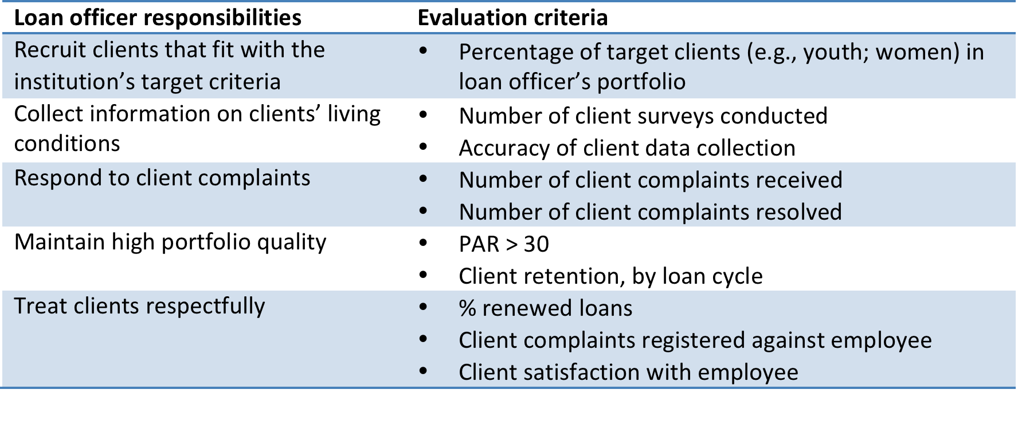
Example of evaluating loan officers on SP criteria

Slide 10


Demonstration of the new SPI4 social audit tool and interview with Bonnie Brusky
The Microfinance Knowledge Exchange Network
Paris-based network specialized in assessment tools for ethical and responsible finance

Slide 11
SPI4 – what is it?
A global social performance assessment tool that integrates emerging industry social performance standards.
Fully aligned with the Universal Standards, the Smart Campaign’s Certification Standards for Client Protection, and the MIX social reporting.
Structured around the 6 Dimensions of the Universal Standards, with indicators for each Essential Practice.
SPI4 will also offer users with a specific mission focus - green, poverty, rural, gender - to assess their practices thanks to optional indicators that reflect the latest industry thinking in these areas.
Notes:
The universal standards have united the sector around a common approach to achieving social goals.
But until now, we have lacked a universally recognized structure and language for consistently evaluating and reporting on all the essential aspects of
social performance management. The SPI4 builds on the SPTF’s work to define indicators for the Universal standards. IT is a universal SP assessment tool that will allow to standardize data collection and reporting throughout the industry.

Slide 12
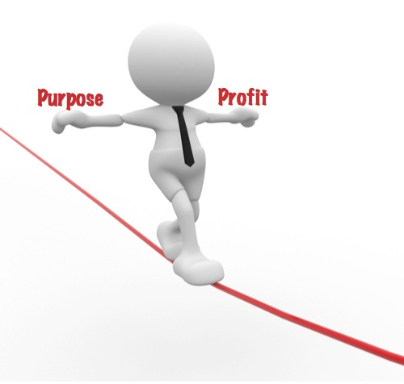








SPI4 – why does the sector need it?
Mainstreaming of SP
Mutliplication of assessment frameworks
Reporting burden on MFIs
Investors due diligence

Slide 13
SPI4 - how was it developed?
Designed through a 1 year consultative process

Slide 14
SPI4 – why use it?
Learn and improve
Decrease FI reporting burden
Increase quality of SP data
Improve SP benchmarks
Serve clients better!
Notes:
Because it fully integrates the Universal Standards, the SPI4 is a comprehensive learning and management tool. Work your way through the six dimensions and you will learn how you measure up against the essential practices required for good social performance management.
Because all stakeholders—donors, investors, TA providers, raters, potentially regulators—will be using the same data collection tool and asking for the same data points, the overall accuracy and completeness will improve over time. This will not only increase increase data quality, it will also help set SP benchmarks,
The SPI4 will help MFIs manage their social performance, spend less time on reporting requirements and more time on improving practices, to better serve our clients!

Slide 15

SPI4 - What does it look like?
  Welcome Page
    Choice of modules
  Organization Information
    Profile and results data
  Questionnaire
    Core USSPM (CPPs integrated)
        6 Dimensions
        19 Standards
        85 Essential practices
        230 Indicators
    Optional modules
  Outputs –scoring tables and graphs automatically generated
    Universal Standards
    Smart Assessment
    SPI
    + Mix reporting, Green, Poverty, Gender,etc.
WELCOME PAGE
ORGANIZATION INFORMATION
SPI4 questionnaire
USSPM
Green
Poverty
CPP
SPI
2
3
1
Notes:
Layout
Each dimension has a different color, aligned with the USSPM infographics
Checkboxes and Dropdown lists
Working on both Windows and Mac
New Welcome Page and ID Card

Slide 16
Demonstration of the SPI4

Slide 17
Is the SPI report useful as a management/Board reporting tool?
Absolutely!
SPI4 fully integrates the Universal Standards
Social dashboard to easily visulize key quantatitive indicators
Graphic results and tables to see how you measure up to the Universal Standards and Client Protection Certification Standards.

Slide 18
How often should the Board receive an SPI report? Sr. management?
Once a year is probably enough – it’s a very comprehensive tool
Many indicators are “baseline” indicators—once you fill them in once, it will be easier to up date on a yearly basis
Institutions might want to use the social dashboard on a more regular basis
SPI4 – a tool to produce MFIs’ annual “social statements”

Slide 19
If my FI already creates an SPM report on a regular basis, how can the SPI help us?
Because it’s so comprehensive, the SPI4 will enable you to monitor ALL aspects of SPM
Because it is standardized, you will be able to compare yourself against performance to industry benchmarks
Because it has the support of a range of industry stakeholders—donors, investors, TA providers, country networks, etc.—social performance reporting requirements will be simplified—everyone asking for the same data!

Slide 20
What resources are required, for using the SPI 4 for regular reporting to the Board/ Sr. management?
Nothing beyond what you have at your disposal!
There are different ways of filling in the SPI4. You can do it alone, as a self-assessment, or call on a trained SPI auditor/reviewer from your national network, from local TA providers, etc. to guide you through the process.
You can also completely outsource the assessment to an external SPI auditor.
Investors and funders, who are also willing to use SPI4, can help you in the process of data verification.
Notes:
! To fill in the SPI4, you'll need to consult your policies and procedures, training materials, operational manuals, and MIS. You'll also want to conduct some interviews with employees and talk to some clients.

Slide 21
Find out more about SPI4
In the beta testing phase now – June 2014
See the beta version of the SPI4 tool on the Wiki page http://spi4wiki.pbworks.com/
Interested in beta testing? Contact us spi4@cerise-microfinance.org
Information webinars for beta-testers: next one is Friday, February 28 at 15h CET (Paris time)

Slide 22
Where to find more resources on Dimension 2
This presentation and audio recording: http://sptf.info/online-trainings/universal-standards-implementation
The Universal Standards Implementation Guide: Coming Soon!
Universal Standards Resource Library: http://sptf.info/spmstandards/standards-implementation-resources

Slide 23
Join us for Dimension3
Topic: Design Products and Services that Meet Clients’ Needs and Preferences
Featuring CGAP
Date: Tuesday 18th March, same time (9am UTC/GMT)
Don’t miss it!

