Slide 1
Dimension 5: Treat Employees Responsibly
The Universal Standards Implementation Series
Today’s speakers:
Natalia Sandler, HR Director, VF AzerCredit, Azerbaijan
Yamini Annadanam, Independent Consultant
April 23, 2015

Slide 2
Agenda
Review of Dimension 5 of the Universal Standards for SPM
Presentation by Natalia Sandler, VF AzerCredit
Discussion with Participants
Wrap-up
Notes:
In today’s session we will be talking with a practitioner from a microfinance institution that is already implementing several of the Essential Practices in the Universal Standards of SPM. We will be able to learn from his/her experience and you will also have a chance to ask questions at the end. We hope to have a engaging conversation and discussion with our speaker and our participants so please do think of questions and comments as we go and send them to me in the chat box as you think of them. I will share these with our speaker at the end of their presentation. But before we begin with the interview, I would like to give you all a brief overview of the Dimension within the Universal Standards that we will be discussing today. Let’s begin!

Slide 3
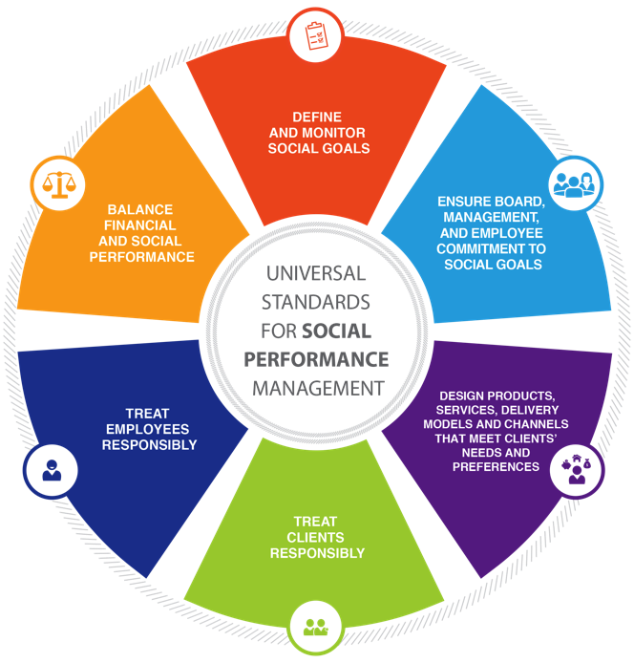
There are 19 standards, organized into six dimensions.
Today we will discuss dimension 5.
Notes:
The Universal Standards cover all parts of social performance management. There are 19 standards, and they are organized into these six dimensions. Today we will discuss dimension [#].

Slide 4
Dimension 5 of the Universal Standards
Title: Treat Employees Responsibly
Rationale: Employees have rights, and employees that are well-treated are more likely to treat clients responsibly
Standards: This dimension has 3 standards and 12 Essential Practices

Slide 5
Dimension 5: 3 Standards
5A. The institution follows a written Human Resources policy that protects employees and creates a supportive working environment
5B. The institution communicates to all employees the terms of their employment and provides training for essential job functions.
5C. The institution monitors employee satisfaction and turnover
Notes:
Usually only two or three Standards fit on each slide so it may take two slides for this. List the exact text of each of the standards in the Dimension.

Slide 6
Dimension 5: Treat Employees Responsibly
Standard
5A. The institution follows a written Human Resources policy that protects employees and creates a supportive working environment.
Essential Practices
A written Human Resources policy is available to all employees, complies with national law, and explains employees’ rights. Employee compensation levels constitute a living wage for employees. The institution accepts and responds to employee grievances through a formal and confidential grievance system. The institution neither employs nor benefits from forced or compulsory labor or illegal child labor. The institution assesses employees’ health and safety risks and takes steps to mitigate them. The institution documents, reports, and investigates all occupational accidents, injuries or diseases.
Notes:
Usually only two or three Essential Practices fit on each slide so it may take two slides for this. List the exact text of each of the essential practices that correspond to the standards the MFI has chosen to talk about.
If the MFI will only present on a few of the EPs in the standard, you can flag these with an arrow or mention them verbally.

Slide 7
Dimension 5: Treat Employees Responsibly
Standard
5B. The institution communicates to all employees the terms of their employment and provides training for essential job functions.
Essential Practices
Each employee receives a written job description and an employment contract. Employees receive job-specific training and/or skill development. Each employee understands how his /her performance will be evaluated and rewarded by the institution.
Notes:
Usually only two or three Essential Practices fit on each slide so it may take two slides for this. List the exact text of each of the essential practices that correspond to the standards the MFI has chosen to talk about.
If the MFI will only present on a few of the EPs in the standard, you can flag these with an arrow or mention them verbally.

Slide 8
Dimension 5: Treat Employees Responsibly
Standard
5C. The institution monitors employee satisfaction and turnover.
Essential Practices
The institution analyzes employee satisfaction. The institution monitors the rate of employee turnover and understands the reasons for employee exit. The institution takes action to correct institutional problems leading to employee turnover and dissatisfaction.
Notes:
Usually only two or three Essential Practices fit on each slide so it may take two slides for this. List the exact text of each of the essential practices that correspond to the standards the MFI has chosen to talk about.
If the MFI will only present on a few of the EPs in the standard, you can flag these with an arrow or mention them verbally.

Slide 9
Reminder! Use the SPI4 Tool to Assess Your SPM Practices
Dimensions
SPI4 is the common data collection and assessment tool for the Universal Standards
Evaluates implementation based on indicators
Standards
Essential Practices
Indicators
Notes:
As many of you remember, the SPI4 tool is a free social audit tool that is fully aligned to the Universal Standards. It uses indicators to evaluate whether an institution is implementing the essential practices found in the Universal Standards manual.

Slide 10
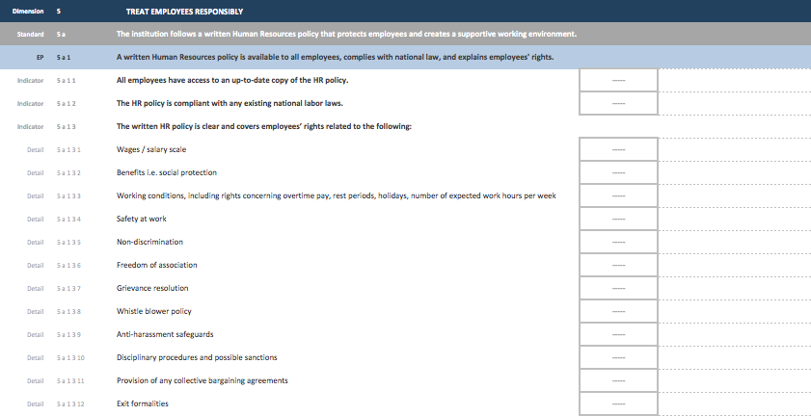
SPI4 Indicators Corresponding to Essential Practice 5A.1
Notes:
Today we are discussing essential practice [#]. [OR, Today one of the essential practices we are discussing is essential practice [#].]
This slide shows [some of] the indicators in the SPI4 tool, used to evaluate whether the institution is implementing essential practice [#].
[Read the indicators on the slide.]

Slide 11
Agenda
Review of Dimension 5 of the Universal Standards for SPM
Presentation by Natalia Sandler, VF AzerCredit
Discussion with Participants
Wrap-up
Notes:
In today’s session we will be talking with a practitioner from a microfinance institution that is already implementing several of the Essential Practices in the Universal Standards of SPM. We will be able to learn from his/her experience and you will also have a chance to ask questions at the end. We hope to have a engaging conversation and discussion with our speaker and our participants so please do think of questions and comments as we go and send them to me in the chat box as you think of them. I will share these with our speaker at the end of their presentation. But before we begin with the interview, I would like to give you all a brief overview of the Dimension within the Universal Standards that we will be discussing today. Let’s begin!

Slide 12
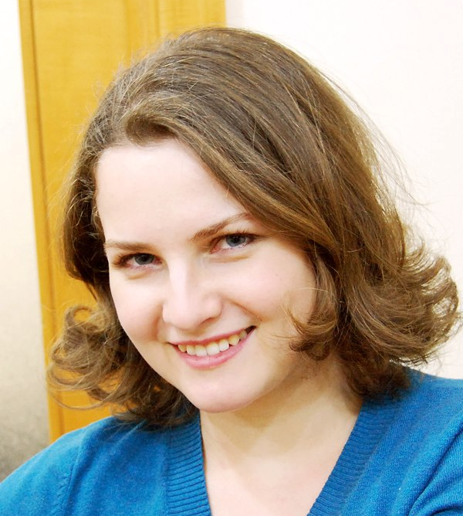
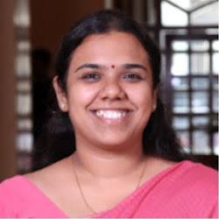
Meet your Speakers!
Name: Natalia Sandler
Title: HR Director
Organization: VF AzerCredit
Email: natalia.sandler@azercredit.az
Name: Yamini Annadanam
Title: Independent Consultant
Email: yamini.avk@gmail.com
Notes:
I have the pleasure of introducing you today to our special guest [name, organization]
[Provide a one minute discussion of your speakers professional experience and their institution.]
12

Slide 13
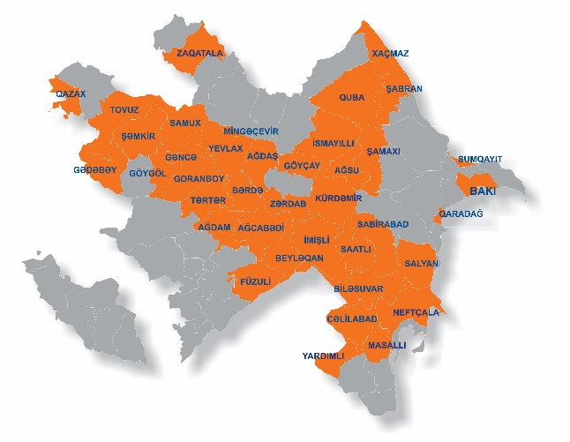
Introduction to VF AzerCredit
VF AzerCredit was initially created in 1996 to provide credit to ensure people can take control over their own lives and livelihoods.
The mission of VF AzerCredit is to provide financial services which have a positive impact on the lives of the poor.
VF AzerCredit currently operates 46 outlets in 40 districts, 22 of which are underserved rural areas.
VF AzerCredit employs over 700 staff members, who are the main asset of the organization.
Notes:
This is the first slide in the MFI’s presentation. Please follow the guidelines below to create your slides for this section of the webinar.
You will have 30 minutes for your presentation
Use between 1-3 slides max for each talking point
Include pictures and graphics whenever possible
Remember that the main content will be presented verbally, but that we want to have these slides to support your presentation and also to inform those members of SPTF that can not join the webinar live.
These slides will be posted online after the webinar as a resource for members wanting to learn more about this topic, along with the recording on today’s session.

Slide 14
What mechanisms have you put in place for meeting the standards of the dimension “treat employees responsibly”?
VF AzerCredit’s Code of Ethics and Business Conduct (COEBC) was issued as a summary of written HR Manual.
Every new joining employee receives a copy of the COEBC along with the written employment contract and job description during the Orientation training provided by AzerCredit Training Academy (ACTA).
Turnover is analyzed on a quarterly basis.
Regular satisfaction surveys are being conducted in all regional offices.

Slide 15
Can you give us an overview of the Code of Ethics and how it relates to dimension 5?
VF AzerCredit’s COEBC was developed in 2010 and revised in 2014.
The Code promotes the company mission, vision and core values among our employees.
COEBC covers the following topics:
integrity of business relationships,
protection of physical and intellectual assets,
conflict of interest,
procurement activity,
entertainment,
gifts and payments,
alcohol and substance abuse,
using company communication systems,
dress and appearance, and professional conduct,
equal employment opportunity (staff rights) and integrity of records,
confidentiality of customer and proprietary information (client rights)

Slide 16
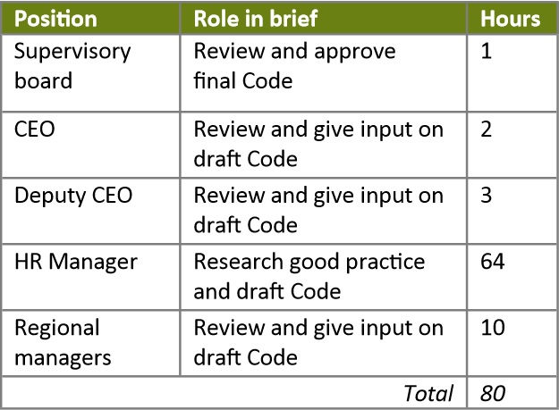
What was the process of developing and implementing VF AzerCredit’s Code of Ethics?
Code development level of effort
In terms of daily implementation of VF AzerCredit’s Code, there are three key junctures that are important to explore:
staff training,
staff appraisal,
internal auditing.

Slide 17
How was the code of ethics disseminated among the staff?
In line with Essential Practice 2c.2 and 2d.2, each new staff member receives a copy of the Code of Ethics when hired, and signs a form to indicate that it has been read and understood.
Additional memos are sent and training sessions are conducted whenever any changes are made to the COEBC.

Slide 18
What were the costs involved in implementing such an initiative?
This table can be used to calculate the estimated cost of the project before its implementation.
To have the total estimated amount, add cost of staff time spent at relevant training sessions.
Don’t forget to consider the costs of COEBC and training materials printing as well.

Slide 19
What are the benefits of these initiatives for VF AzerCredit?
For VFAzerCredit, the biggest benefit of its Code of Ethics is an intangible one - that we enact our values in every single step, and are proud of it.
COEBC has allowed us to ensure coherent and systematized work principles and create supportive working environment.
Since putting it in place, it has definitely improved the customer service function of our field staff.
Availability of well prepared and properly applied HR policies and procedures, including Code of Conduct is a prerequisite for the SMART Campaign Client Protection Certificate, which AzerCredit has recently received

Slide 20
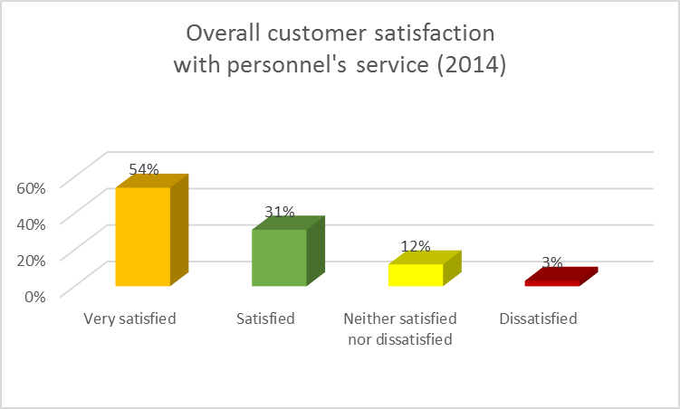
How have these practices benefitted your clients and staff?
COEBC:
Helps acquaint new employees with the company culture and values.
Guides employees in situations where the ethical course of action is not immediately obvious.
Minimizes subjective and inconsistent management standards, which leads to enhancing morale, employee pride, loyalty and the recruiting of outstanding employees.
At all focus group discussions conducted with customers it is reconfirmed that VF AzerCredit staff are patient, friendly and honest which makes it easy to trust the organization in comfort, as such, their friendly attitude toward clients is considered the most valuable strength of VF AzerCredit.

Slide 21
What advice do you have for other practitioners who want to practice standards of this dimension?
First, to get buy-in from the Management/Supervisory Board.
Ensure the necessary capacity is in place in the HR Department for project realization.
Put international best practice through a local lens.
Make it a living document.

Slide 22
Agenda
Review of Dimension 5 of the Universal Standards for SPM
Presentation by Natalia Sandler, VF AzerCredit
Discussion with Participants
Wrap-up
Notes:
In today’s session we will be talking with a practitioner from a microfinance institution that is already implementing several of the Essential Practices in the Universal Standards of SPM. We will be able to learn from his/her experience and you will also have a chance to ask questions at the end. We hope to have a engaging conversation and discussion with our speaker and our participants so please do think of questions and comments as we go and send them to me in the chat box as you think of them. I will share these with our speaker at the end of their presentation. But before we begin with the interview, I would like to give you all a brief overview of the Dimension within the Universal Standards that we will be discussing today. Let’s begin!

Slide 23
Agenda
Review of Dimension 5 of the Universal Standards for SPM
Presentation by Natalia Sandler, VF AzerCredit
Discussion with Participants
Wrap-up
Notes:
In today’s session we will be talking with a practitioner from a microfinance institution that is already implementing several of the Essential Practices in the Universal Standards of SPM. We will be able to learn from his/her experience and you will also have a chance to ask questions at the end. We hope to have a engaging conversation and discussion with our speaker and our participants so please do think of questions and comments as we go and send them to me in the chat box as you think of them. I will share these with our speaker at the end of their presentation. But before we begin with the interview, I would like to give you all a brief overview of the Dimension within the Universal Standards that we will be discussing today. Let’s begin!

Slide 24
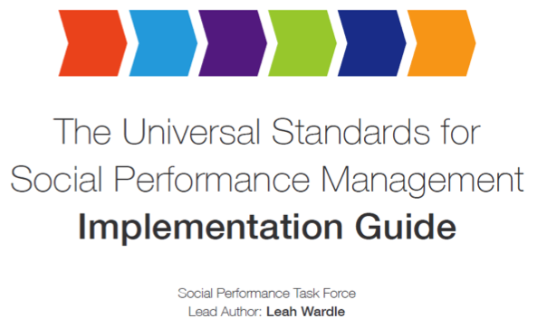
Take Action: Use the Implementation Guide!
Download the guide here: http://sptf.info/spmstandards/universal-standards
Notes:
After your institution has evaluated its practices and prioritized areas for improvement, look to the Universal Standards Implementation Guide to help you improve your practices. [Note to facilitator: consider sharing your screen for this portion of the presentation, so that the audience can see where to find the Implementation Guide on the website, and you can show the cover pages for each section of the Guide]
This Guide is everything you ever wanted to know about SPM, in one document. This is guidance on how an institution achieves each of the universal standards. I will give you a brief overview of what’s included in the Guide, so that when you go to use it, you’ll already be familiar with the contents.
Chapter 1—(Show page 14 of the Guide if you are sharing your screen) Presents a five-step plan for using the Universal Standards. We talk about how to introduce them in your organization, assess your institution’s practices, and create an SPM action plan that is integrated with your organization’s overall strategic plan.
Chapter 2—(Show page 26 of the Guide) This chapter is called Using Social Performance Data for Decision-making. It lists 20 practical issues that managers face—such as how to retain employees and how to reach target clients—and then for each of those issues, the Guide lists which data you need in order to make good decisions on that topic, as well as which managers should have access to the data. This is a great, practical tool for managers and the board.
Chapter 3—(Show page 46 of the Guide if you are sharing your screen) Chapter 3 lists each and every standard and essential practice found in the Universal Standards. For each of the 85 essential practices, it provides guidance on how to implement that practice. The guidance is very straightforward and practical. So, once you’ve identified one or more practices you want to work on, this chapter is where you find practical ideas for how to do it.
Finally, the Resource Annex—(Show page 176 if you are sharing your screen) For every standard, the resource annex provides information and links to other industry resources on the topic. When you are working on a specific standard, you can use the Resource Annex to find links to other tools and publications that you can use to take the next steps as you work to improve practices in your FI.
So now you are familiar with the 4 main parts of the Guide, and I hope this helps you see all the possibilities that exist for how you can use it. I want to remind you that the Guide is very long because it is a reference guide and so you do not need to read the whole document cover to cover, but rather can look up the information that is useful to you when you need it.

Slide 25
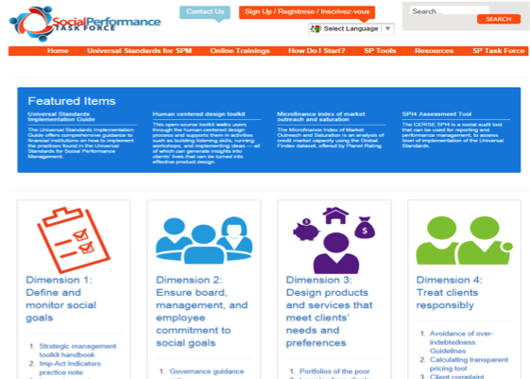
Take Action: Consult the Resource Center!
Visit the resource center here: http://sptf.info/resources/resource-center
Notes:
Before this webinar, I consulted the SPTF online social performance resource center to see what resources were available related to the practices we will be discussing today. I would like to draw your attention to X, Y, Z. [Facilitator should share his/her screen to show where the resource is found in the resource center, and then show the resource itself.]

Slide 26
Where to find more information:
The Universal Standards of SPM Manual: http://sptf.info/spmstandards/universal-standards
The SPI4 social audit tool: http://cerise-spi4.squarespace.com
The presentation and recording from today’s session:
http://www.sptf.info/online­trainings/universal­standards­ implementation
The SPTF Resource Center:
http://www.sptf.info/resources/resource­center
The SPM Implementation Guide:
http://sptf.info/spmstandards/universal-standards

Slide 27
Thank you for your participation!
Please join us in May 2015 for a discussion about how to improve practice in:
Dimension 6: Balance Financial and Social Performance
Notes:
If you don’t know the date and time for the next session simply say “Please join us for Dimension X next month. We will follow up over email with more details as they become available.”

