Slide 1
Dimension 6: Balance Social and Financial Performance
The Universal Standards Implementation Series
Today’s speakers: Leah Wardle, SPTF and Christophe Bochatay, Triple Jump
July 15, 2014

Slide 2
Agenda
Review of Dimension 6 of the Universal Standards
Presentation by Christophe Bochatay, Triple Jump
Discussion with Participants

Slide 3
Dimension 6 of the Universal Standards
Title: Balance Social and Financial Performance
Rationale: An institution’s financial decisions and results should reflect their social goals.
Four standards:
6a- Growth
6b- Returns & financing structure
6c- Pricing
6d- Executive compensation

Slide 4
6a- The institution sets and monitors growth rates that promote both financial sustainability and client well-being.
Essential Practices
Set a policy on sustainable target growth rates, for all branches/regions and all product types, considering the institution's growth capacity and the markets being targeted. Analyze growth rates and market saturation to assess whether growth policies ensure both financial sustainability and client well-being. Monitor whether internal capacity is keeping pace with institutional growth in number of clients and amount of loans and deposits, and enhance that capacity as needed.

Slide 5
6b- Equity investors, lenders, board and management are aligned on the institution’s double bottom line and implement an appropriate financial structure in its mix of sources, terms, and desired returns.
Essential Practices
Set clear policies on desired level of returns and on how those returns will be used. Engage with funders whose expectations for financial returns, timeframe and exit strategies are aligned with your social goals and stage of development. When deciding on funding sources, understand what cost would be passed on to the client. Protect client savings and cash collateral. Maintain a transparent financial structure.

Slide 6
6c- Pursuit of profits does not undermine the long-term sustainability of the institution or client well-being.
Essential Practices
Set market-based, non-discriminatory pricing. Ensure efficiency ratios are aligned with peers. Do not charge excessive fees. Monitor whether pricing levels are consistent with your policies on returns. Establish a field-officer-to-client ratio that promotes high service quality for clients.

Slide 7
6d- The institution offers compensation to senior managers that is appropriate to a double bottom line institution.
Essential Practices
Ensure that compensation of the CEO/Managing Director and other senior employees is in line with your social goals. If senior management compensation is in part incentive-based, include the social performance evaluation. Upon request, transparently disclose compensation to regulators, auditors, raters, donors, lenders, and investors. Calculate the difference between the average compensation of top level executives and field employees, and analyze whether this spread is consistent with the your mission.

Slide 8
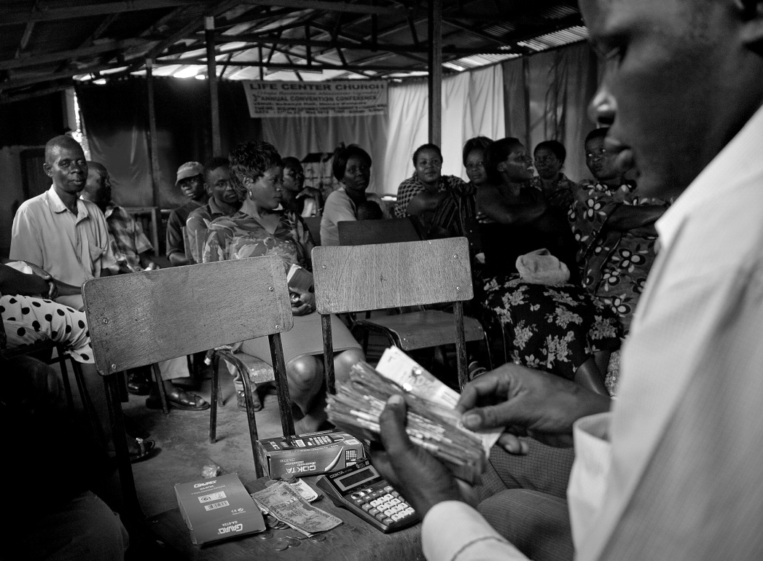
Presentation by Christophe Bochatay, Triple Jump Senior Investment Officer, Africa & Middle East

Slide 9
Introduction to the Interest Traffic Light ->Universal Standard 6C
Profitability can come at the expense of clients’ well being. A double bottom line institution needs to balance profitability and social mission.
Imperfect competition and vulnerability of clients mean that markets are not self-regulating. Investors have a strong role to play to contribute to responsible pricing and profits.
The appropriate level of interest rate depends from a complex mix of factors including social mission, costs, competition, regulation, etc.
Structured and consistent approach
The Interest Traffic Light
A selection tool to evaluate whether Interest Rates charged by MFIs and their Profitability are justified or not.
First introduced by TJ in 2010
Objectivity
Transparency
Accountability

Slide 10
Part I screens 3 criteria to establish if deeper analysis is needed
Criteria
Question asked / Input factors
Threshold
APR ⁽¹⁾
What is the average APR of the MFI?
APR of each of the MFI loan products
Number of outstanding loans
Weighted average APR > 50%
A
APR relative to peers
How does the APR compare to APR of peers?
Average APR as calculated under (1) above
APR of 3 most similar MFIs in the country
Average APR > 1.2x peer average
B
Profitability
How profitable was the MFI over last 3 years?
Return on Assets (RoA)
Return on Equity (RoE)
RoA > 6%
RoE > 25%
C
If one of the three Criteria is above the Threshold, then a deeper analysis is required: Part II needs to be filled
Annual percentage rate (non-compounded)

Slide 11
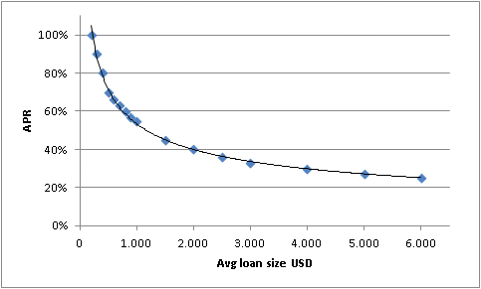
Part II analysis looks in more details at APR and profitability…
Dimension
Question asked / Input factors
Scoring points
LEAST
MEDIUM
MOST
1
APR
What is the average APR of the MFI?
> 80%
50-80%
< 50%
2
APR vs loan sizes
How does the APR relate to average loan size?
Use approx. “universal” APR vs. loan size curve
Divide APR of MFI / APR indicated by curve
> 1.1x
0.9 – 1.1x
< 0.9x
3
APR relative to peers
How does the APR compare to APR of peers?
> 1.2x
0.8 – 1.2x
> 0.8x
4
Profitability
What is the level of RoA?
> 6%
2-6%
< 2%

Slide 12
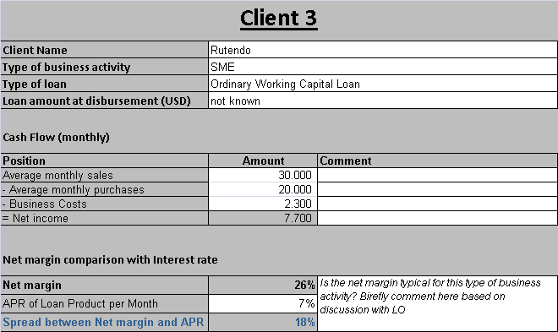
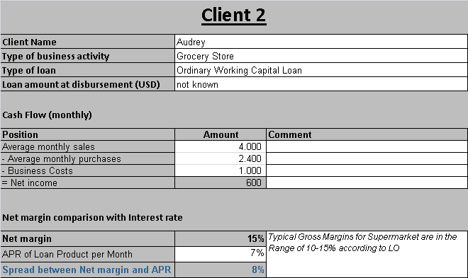
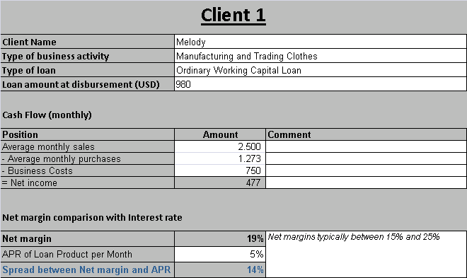
… compares interest rates to business returns of end clients…
Dimension
Question asked / Input factors
Scoring points
LEAST
MEDIUM
MOST
5
Added value to clients
Spread between APR charged by MFI and end borrower’s net business margin
<2%
2-10%
>10%

Slide 13
… and considers a number of mitigating factors
Dimension
Question asked / Input factors
Scoring points
LEAST
MEDIUM
MOST
6
Cost in the operating environment
Are there specific factors in the environment that contribute to higher than usual costs for the MFI?
High salary levels
Very rural MFI with large distances
High administrative costs
High borrowing costs
Inflation 10% or above
no
1 factor
2+ factors
7
Efforts to lower rates
Did the MFI lower APRs and/or has credible plans to do so in the near future?
No
Has lowered rates or has plans to do so
both
8
Use of profits
Does the MFI distribute its profit or reinvest it in the institution?
> 33% dividend
< 33% dividend
No dividend
9
Equity cushion
Are there factors in which make it necessary to build up an equity cushion?
Below standard solvency
Specific regulatory requirements which the MFI struggles to fulfil
Currency fluctuation 15% or above
Significant political instability
Recurring natural disasters…
no
1 factor
2 factors

Slide 14
Outcome of traffic light influences TJ investment decision
GREEN: No specific actions required, general monitoring of situation
YELLOW: The following set of actions should be implemented, taking into consideration the sustainability of the MFI:
Approval of the loan subject to a commitment in writing from the MFI to lower effective rates within a 12-18 month period (e.g. the MFI agrees to pass on reductions in the total cost ratio to clients)
Loan Tenor reduced to a maximum of 24 months
TJ Investment Officer to review effective interest rate annually and result to be included in annual progress report to the fund under management.
RED: Not eligible for investment

Slide 15
Download the Interest Traffic Light at:
www.interesttrafficlight.org

Slide 16
Executive Compensation Questionnaire ->Universal Standard 6D
Developed to standardize our assessment of CEO’s remuneration package and designed to provide our investment committees all the elements to make a decision
TJ requires the MFI to be transparent on the compensation of its CEO
We define here the CEO compensation package as the gross sum of salary, bonuses and pension benefits received by the CEO during the last fiscal year
All MFIs reporting a total CEO compensation package above USD 150.000 must be further assessed through a set of 6 questions

Slide 17
Executive Compensation Questionnaire
Is the structure of the compensation package appropriate?
Incentive systems and inclusion of longer term targets
Stock options
Is the board setting compensation and is the board sufficiently independent
Ratio of CEO compensation to the one of junior loan officers
Is the compensation package in-line with executive compensation packages of peers?
Are there elements that make the MFI a particularly complex institution to manage?
Legal form
Size of the institution

Slide 18
Executive Compensation Questionnaire
Does the performance of the CEO stand out?
Compare performance against peers in terms of growth, sustainability, outreach and SPM
Are there any elements in the operating environment that justify higher compensation?
Living expenses, hardship, availability of skilled executives
Are profits and interest rates at acceptable levels?
Is the Interest Traffic Light green?

Slide 19
Discussion with Participants

